Slide 1
The Curriculum Change Process: Updates for 2024-25 Michael Pullin, Dean for Academic Initiatives Vazgen Shekoyan, Associate Professor of Physics Ingrid Jaramillo Estrella, Enrollment Registrar Manager

Slide 2
Agenda
The curriculum change process
Overview
Department
Curriculum committee
Academic Senate
CUNY Board
NYSED
CUNY First and Degree Works
QCC Catalog
Timeline for 2024-25
Coursedog
Do you remember Schoolhouse Rock?

Slide 3
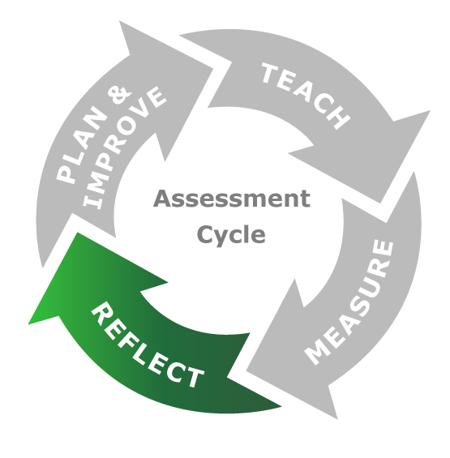
Curriculum Change - Overview
At QCC, the faculty have primary responsibility for degree programs and credit-bearing courses
What learning objectives are expected of students in a degree?
What courses are needed to teach students those concepts and skills?
How are those courses organized into a degree?
New programs and courses are proposed and then changed over time
Reflect changes in the field
Improve student outcomes
Ideally, in response to assessment

Slide 4
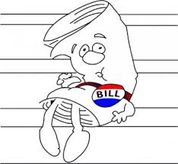
Overview
5 types of changes possible
New Program
Change Program
New Course
Change Course
Delete a course/program
All changes follow a process
Starts in a Department
Curriculum Committee
Academic Senate
CUNY Board
NYSED (sometimes)
Registrar’s Office
Added to the Catalog

Slide 5
Academic Department
The process starts at the Academic Department
Academic matters must be voted on and approved by the Department before sending it to the Curriculum Committee.
Departmental curriculum lead will submit the changes to the Curriculum Committee.
The Curriculum Committee has a one-week lead time. Items submitted less than one week before the next Curriculum Committee meeting will be considered at the following meeting.
If an academic matter might be of concern to another department, the proposing department chair must consult with the chair of that department. If concerns are not resolved, contact OAA or Curriculum Committee chair.

Slide 6
Curriculum Committee
The Curriculum Committee
A subcommittee of the Academic Senate
Members are both faculty and professional staff
Dean Pullin is a non-voting representative for the Office of Academic Affairs
The committee considers all proposed changes
Meets every Tuesday at 2:00 pm
As needed
No meeting on the Senate meeting days
The department chair or a faculty representative from the department attends the meeting to answer questions on proposed changes.
The committee members vote on changes, a simple majority to pass

Slide 7
Academic Senate
The Academic Senate must approve all curriculum changes
Meets every second Tuesday of the month.
The Senate requires two-weeks notice before it considers items from committees.
The Curriculum Committee chair presents the Committee’s report and recommendations at the meetings
A simple majority to pass
Experimental Courses
Only the Committee’s and the President’s approval is needed.
The course can be taught only for two semesters.
Used to “try out” possible new courses

Slide 8
The CUNY Board
The CUNY Board of Trustees
The governing body for all of CUNY
Must approve all curriculum changes for all colleges
Meets six times per calendar year
Two-month lead time for items to be considered
Curriculum changes are submitted to the Board in ”Academic Reports”
Dean Pullin is responsible for reporting to the Board
Once approved, the reports are publicly available at this CUNY website

Slide 9
NYSED
In some cases, the New York State Education Department (NYSED) must also approve changes to degree programs.
More than 1/3 of degree program required credits affected
Adding or eliminating a concentration
Change of degree type (A.A.S., A.S., A.A.)
Program Title
Mode of delivery
Total credits required
Full list
CUNY Office of Academic Affairs submits changes to NYSED
Approval can take months

Slide 10
CUNYfirst and Degree Works
Once CUNY Board and NYSED approvals are received, the changes are implemented by the Registrar’s Office in CUNYfirst and Degree Works
Changes can only be made once they appear in the published Academic Reports
CUNYfirst
University-wide database of information
Courses and degree programs are defined
Degree Works
Allocates courses taken to fulfillment of degree requirements
Use for advising and to determine if a student can graduate
Changes must be “scribed” to take effect
In the past, changes to CUNYfirst and Degree Works were made directly
Coursedog now makes changes automatically (more later)
Changes can only be made after they are published in Academic Reports

Slide 11
CUNYfirst and Degree Works
For some changes, the Central Office must update CUNYfirst
To add new programs (majors), new concentrations, discontinue programs when changes are made, example: DP-AAS to CIS-AS
Important note: The academic year (catalog year) of a student and the program of study are set in CUNYfirst.
The basis of the changes made in Degree Works is the academic reports
Degree Works tables located in CUNYfirst
Academic year (catalog year) changes
Pathways courses
Major courses
New programs and concentrations
What-If audits
Audits not displaying completely

Slide 12
Catalog
The catalog is the formal home for all course and degree information
It is updated yearly by the Offices of Academic Affairs and Media and Communication
In the past, all changes were made manually
In Page Maker for PDF/paper catalogs
In Coursedog since 2021-22
Curriculum changes are published in the catalog once per year only
No mid-year changes
Addendums issue in special circumstances – e.g. the pandemic

Slide 13
Timeline for 2024-25
In the past, changes made as late as the May Senate Meeting were implemented for the next academic year
Not considered by CUNY Board until late June
Delayed changes in CUNYfirst and new catalog until August
Changed courses can’t be scheduled until late summer
Students start registering in the prior spring
Difficult to advise students
Starting this year, the next catalog will be issued in March
In time for students and advisors to understand requirements during registration
Changed courses can be scheduled at start of registration
Changes for next catalog year must be approved at the November Senate Meeting
Let’s look at the timeline

Slide 14
Curriculum Committee Meeting¹ | Academic Senate Meeting | CUNY Board Meeting³ | Catalog Year
9/3/24 | 10/8/24 | Feb-25 | 2025-26
9/17/24
9/24/24
10/1/24
10/15/23 | 11/12/24
10/22/24
10/29/24
11/5/24 | 12/10/24 | Apr-25 | 2026-27
11/19/24
12/3/24 | 2/11/25 | May-25
1/28/25
2/4/25 | 3/11/25 | Jun-25
2/18/25
2/25/25
3/4/25 | 4/8/25
3/18/25
3/25/25
4/1/25 | 5/13/25 | Oct-25
4/15/25
4/22/25
4/29/25
5/6/25 | Sept-25 | Dec-25
The catalog for the next year will be released no later than March 15th
New deadline for inclusion in the next year’s catalog
Must be submitted to the committee by 10/22
Proposals to NYSED must be approved no later than February 15th of the prior year to appear in next year’s catalog

Slide 15
Coursedog
Coursedog is a software system that is being implemented across CUNY
Course and room scheduling
Catalog production
Curriculum changes
The curriculum change process is being moved into Coursedog this year
Web forms instead of MS Word forms
Follow approval process in Coursedog
Once Curriculum changes are approved, they will be made automatically in CUNYfirst, Degree Works, and the catalog
Departmental curriculum leads, curriculum committee members, and Senate leadership are now being trained in Coursedog

Slide 16
Summary
Academic Department
Curriculum Committee
Academic
Senate
CUNY
Board
Changes made in CUNY Start
There are long lead times between some steps
In the past, timing of the process led to confusion and problems for departments, advisors, and students
New deadline for approval of curriculum changes for next catalog year is in November
Change process is moving to Coursedog
NYSED
(if needed)
Revised and new courses and programs available for students
Curriculum changes made in catalog for the next year

Slide 17
THANK YOU

Slide 18
Questions?

