Slide 1
How to Apply to College Now For Fall 2025

Slide 2
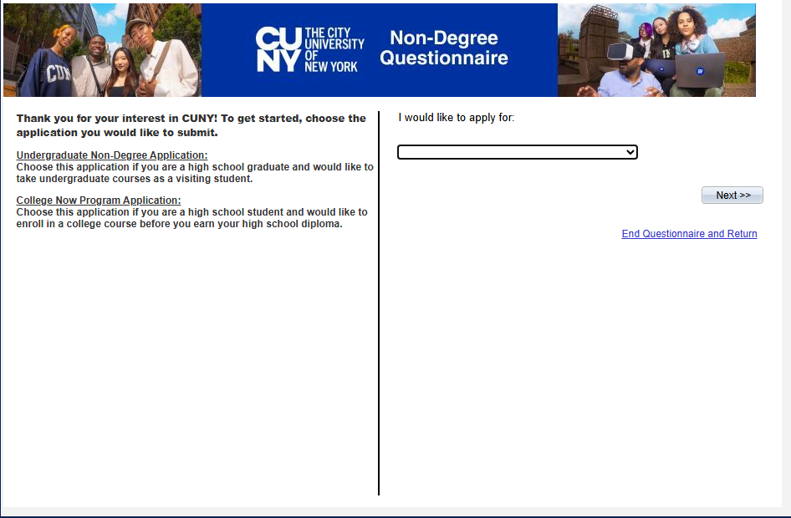
Go to the QCC website >> Academics >> College Now >> Apply for Fall 2025

Slide 3
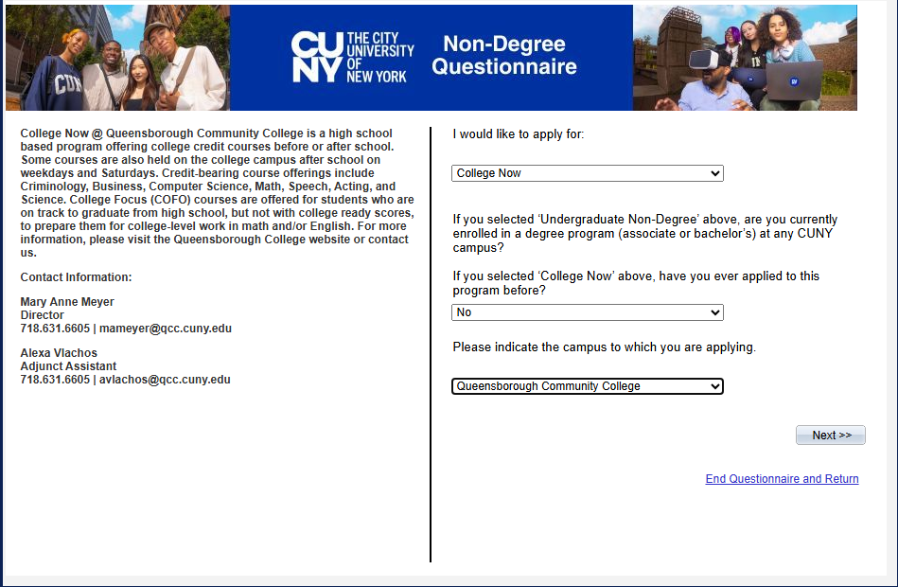
Once Completed, Click “NEXT”

Slide 4
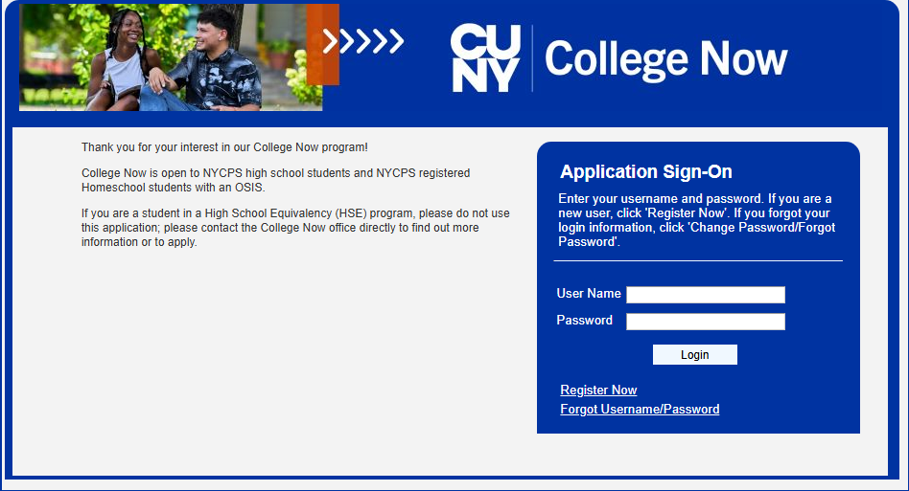
For new user, click “Register Now” Existing users can sign in

Slide 5
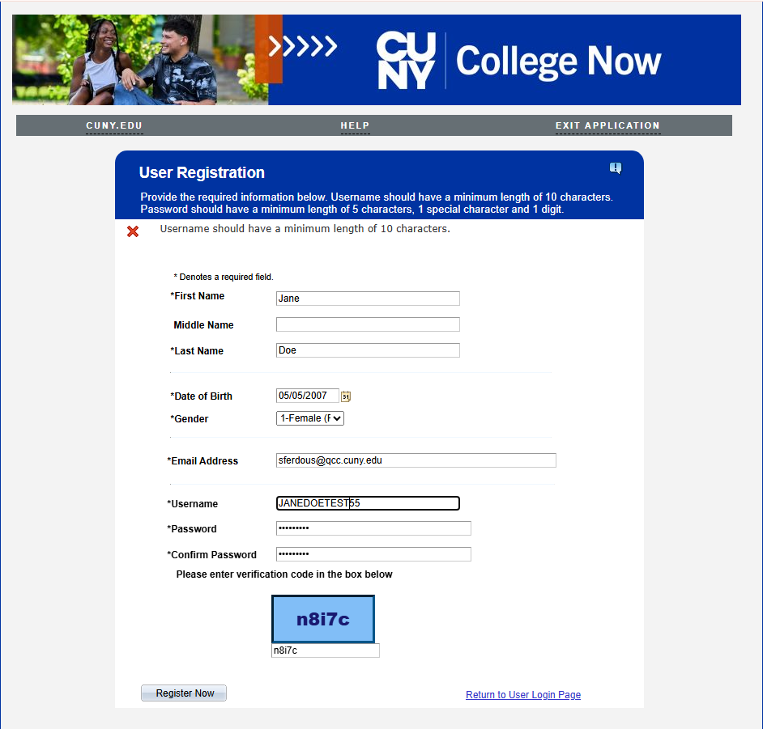
Once Completed, Click “Register Now” You will receive YOUR OWN verification code; type the code YOU RECEIVE into the blue box

Slide 6
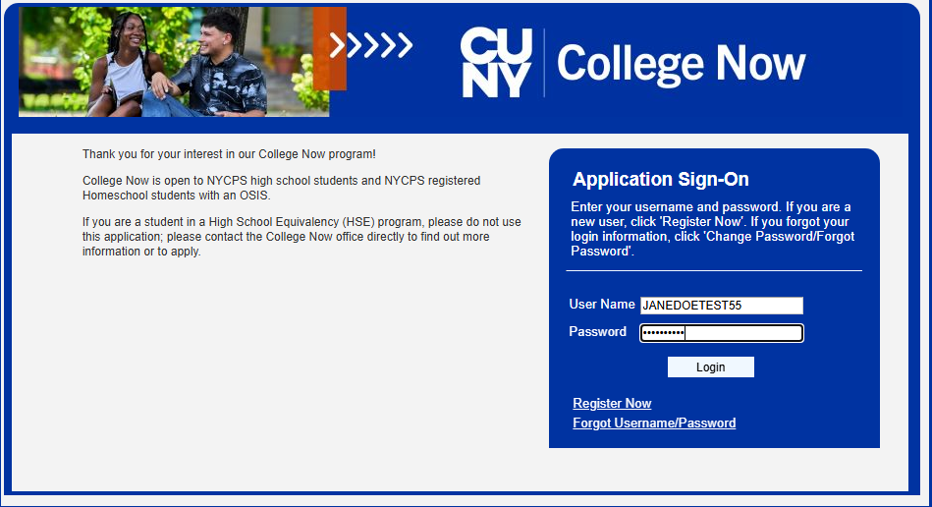
Sign in with username and password

Slide 7
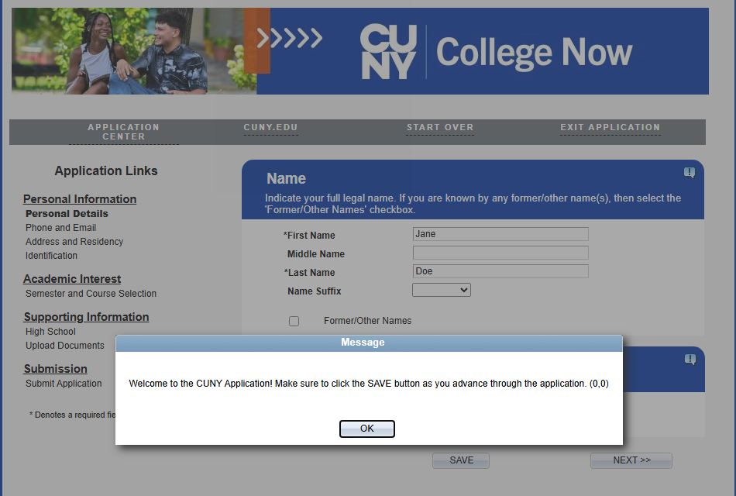
After login, this page appears first. Click “OK”

Slide 8
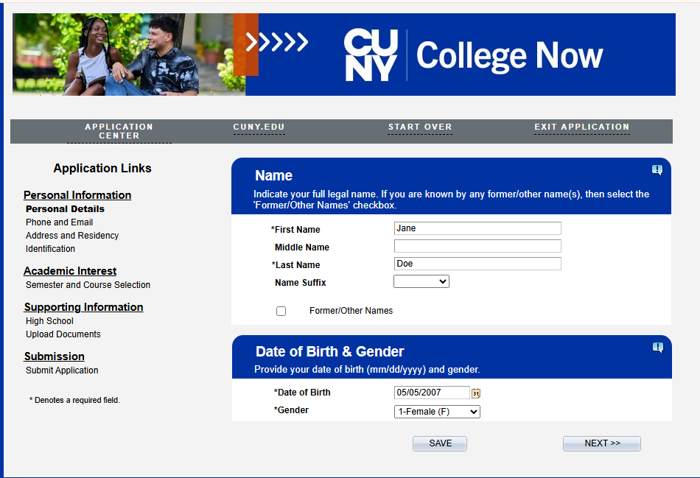
Once Completed, Click “SAVE” and then “NEXT”

Slide 9
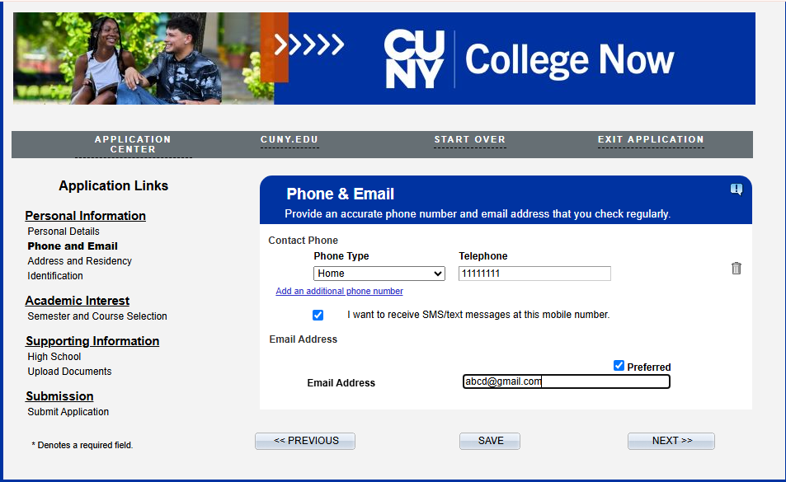
Once Completed, Click “SAVE” and then “NEXT”

Slide 10
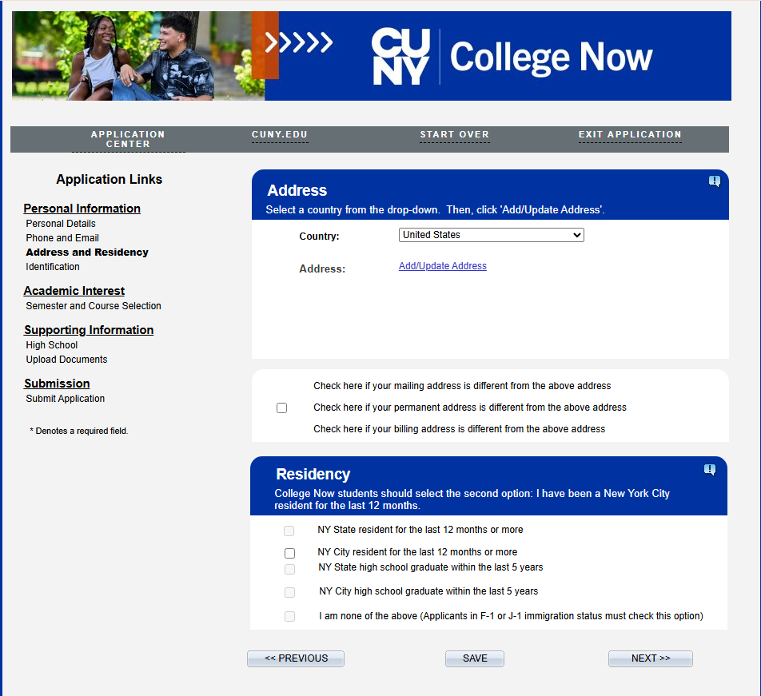
To Add Address Click Add/Update Address Once Completed, Click “SAVE” and then “NEXT”

Slide 11
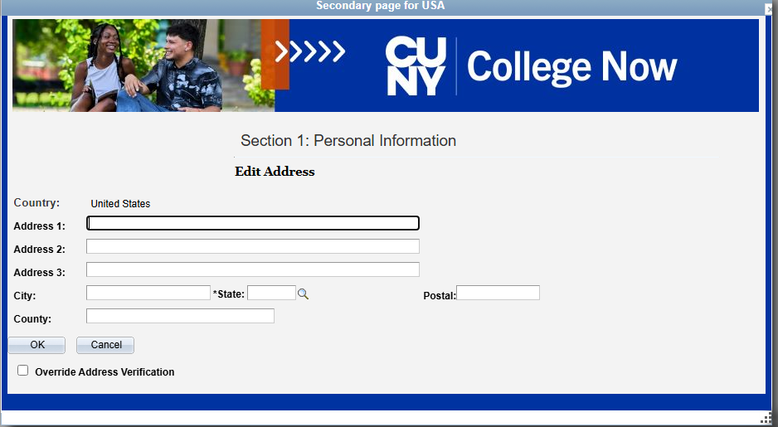
Once Completed, Click “OK”

Slide 12
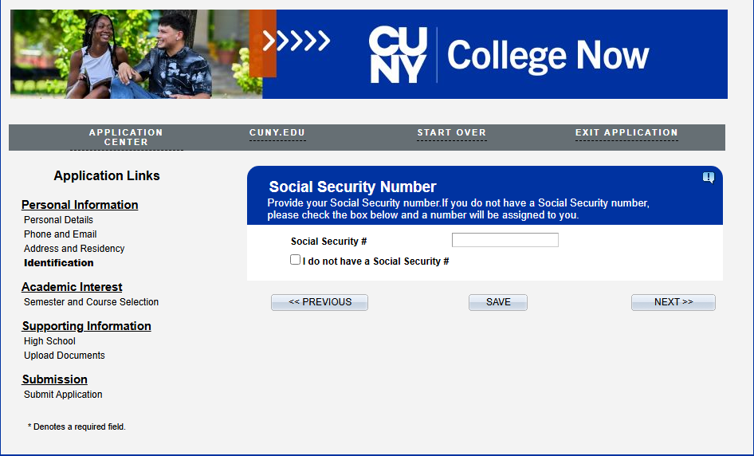
Once Completed, Click “SAVE” and then “NEXT” If you do not have a social security number, click the box I do not have a Social Security #

Slide 13
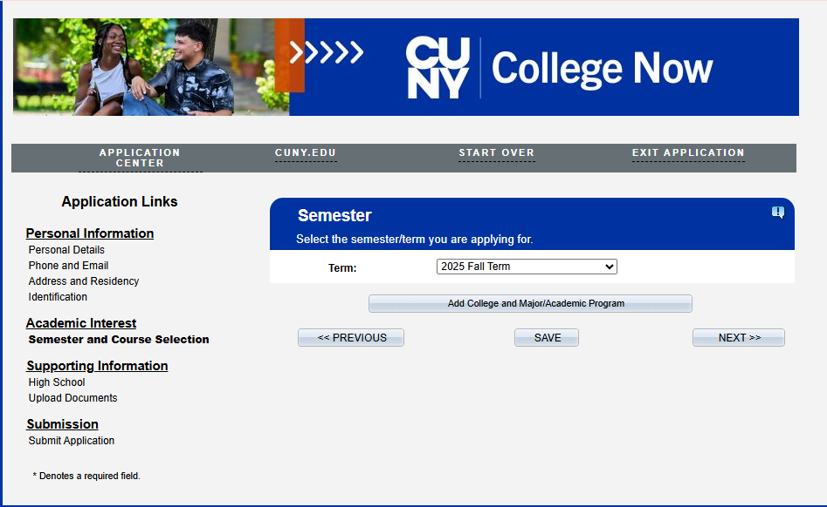
Click “Add College and Major/Academic Program” Once Completed, Click “SAVE” and then “NEXT”

Slide 14
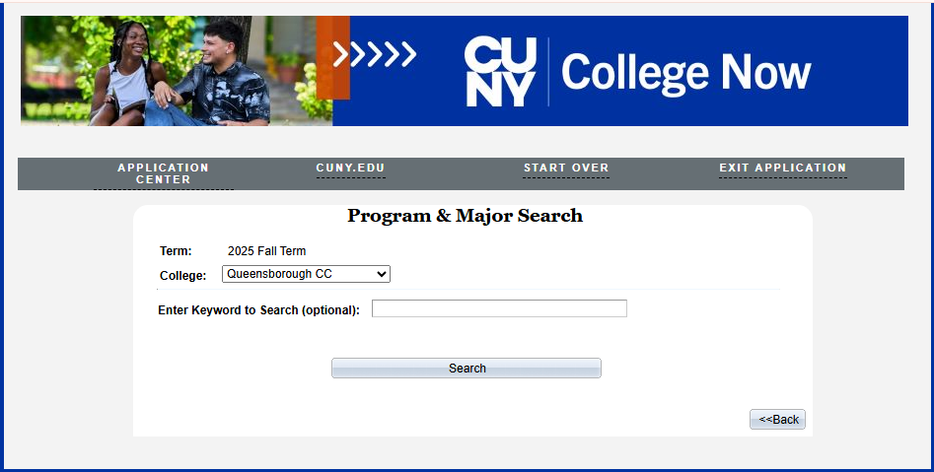
Once Completed, Click “BACK”

Slide 15
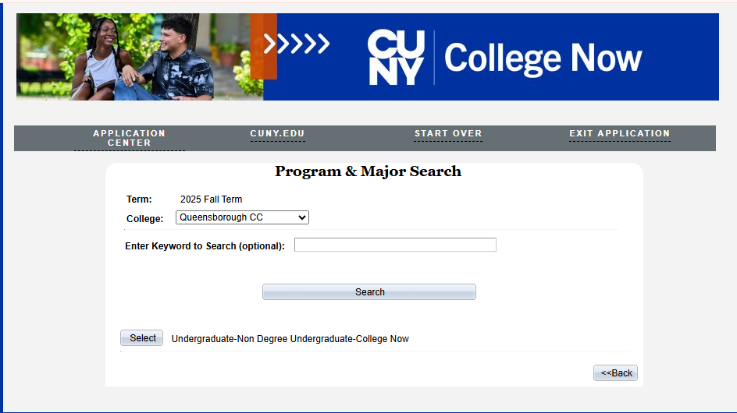
Click “SELECT”

Slide 16
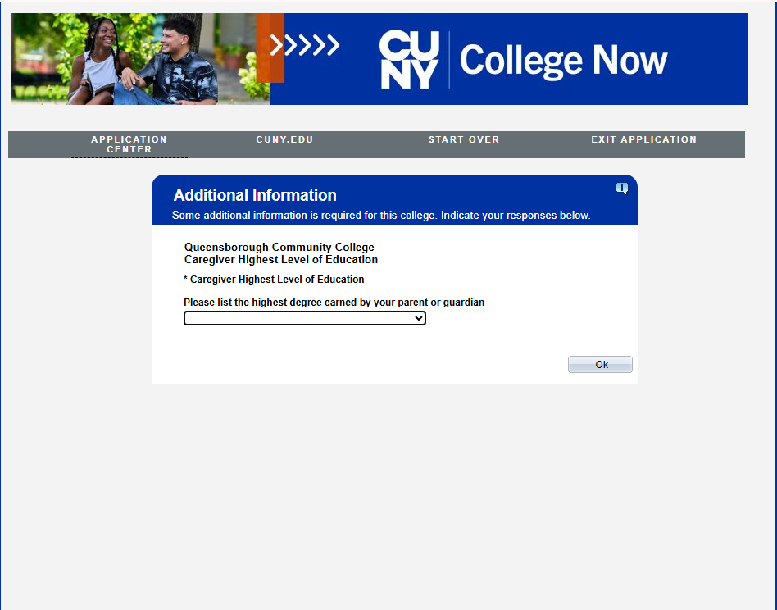
Once Completed, Click “OK”

Slide 17
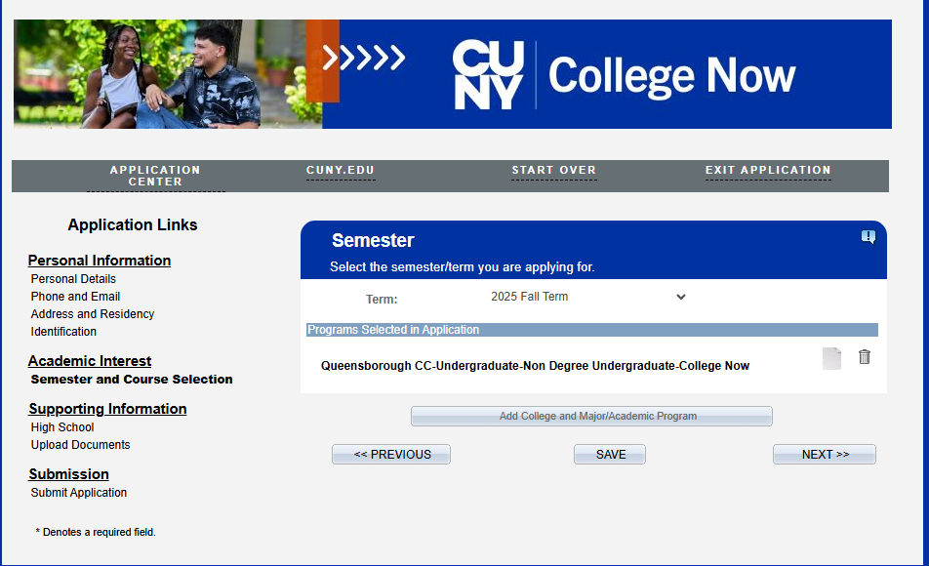
Once Completed, Click “SAVE” and then “NEXT”

Slide 18
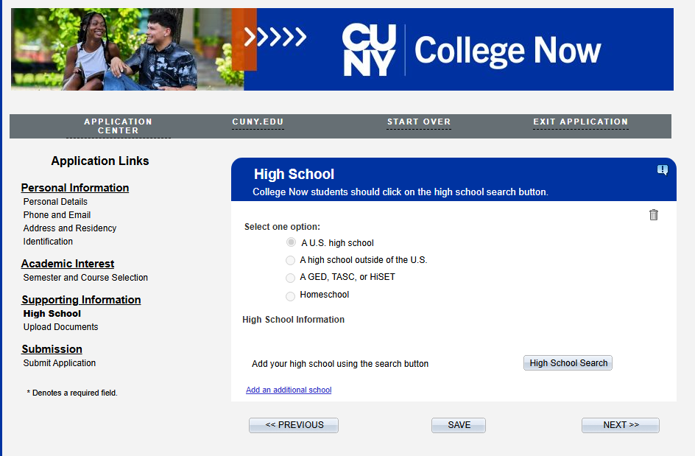
Click “High School Search” Once Completed, Click “SAVE” and then “NEXT”

Slide 19
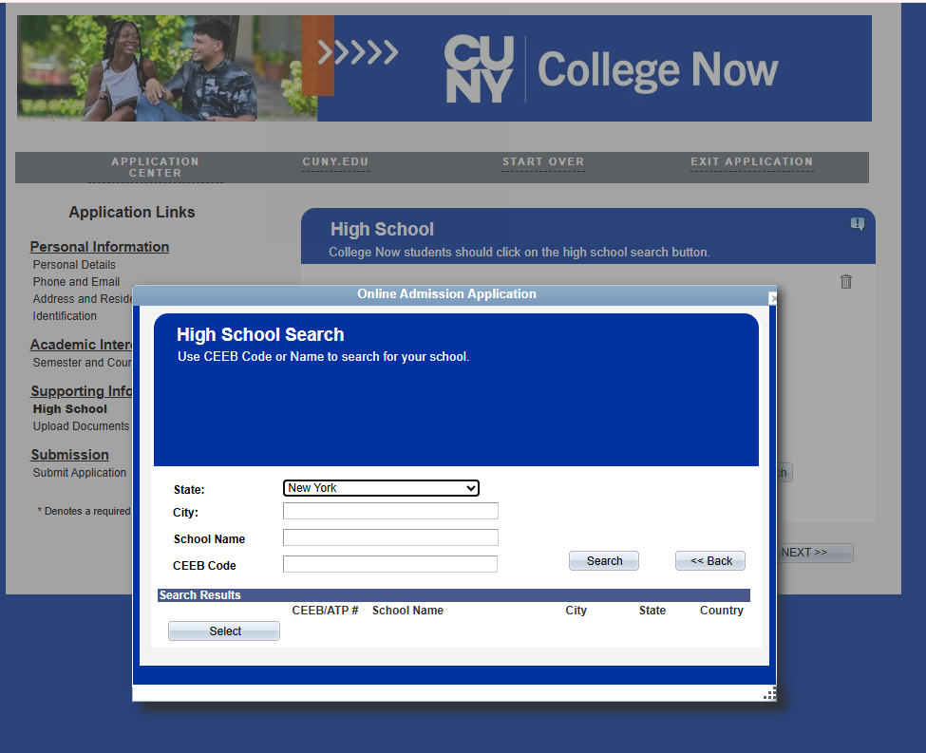
Once Completed, Click “SEARCH”

Slide 20
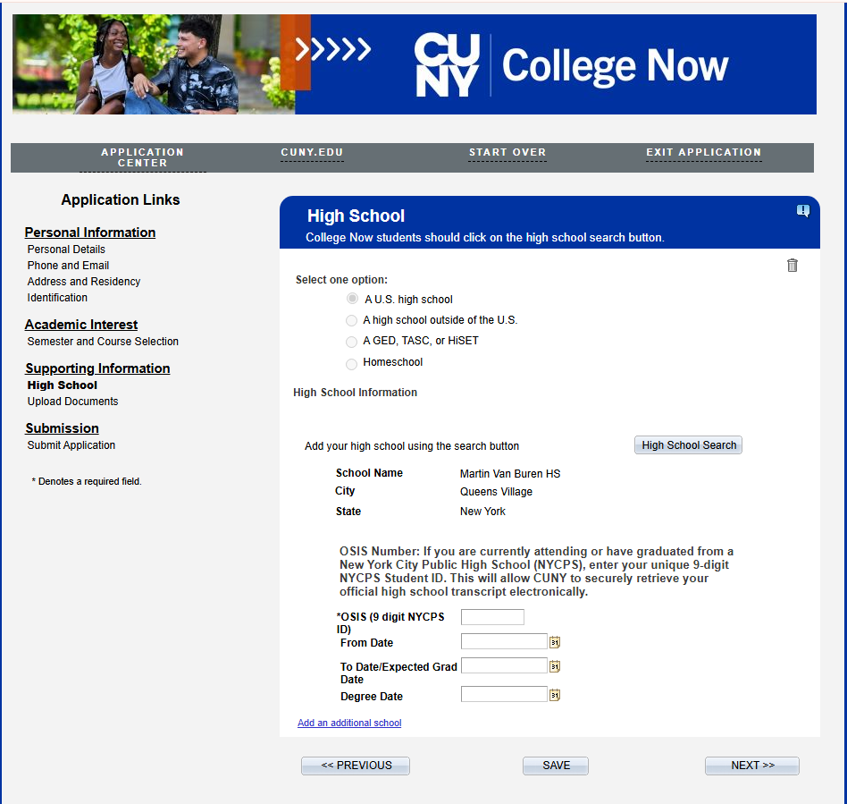
Once Completed, Click “SAVE” and then “NEXT”
Type in your OSIS number here
“From Date” is your first day of high school
“To Date/Expected Grade Date” is expected date of Graduation from high school
“Degree Date” is the same as Expected Date of Graduation from high school

Slide 21
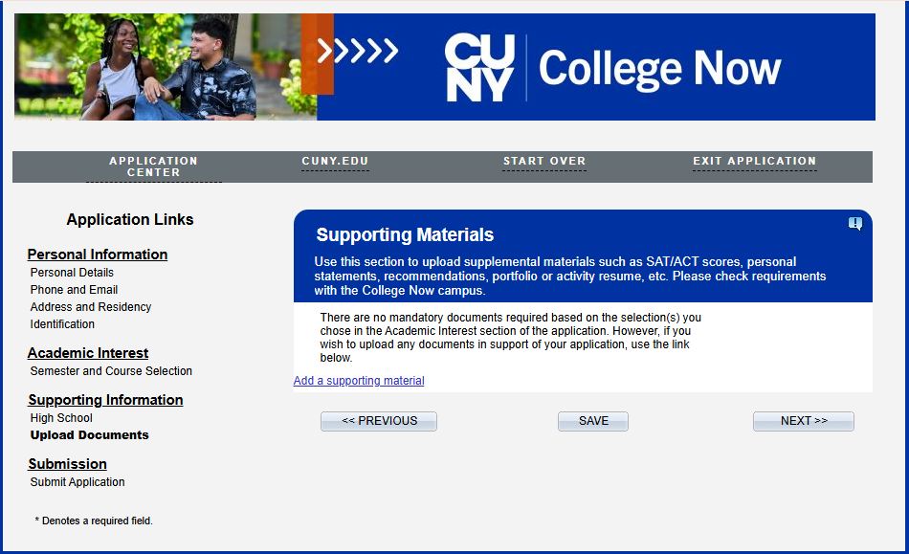
Click “Add a supporting material” to upload transcript Once Completed, Click “SAVE” and then “NEXT”

Slide 22
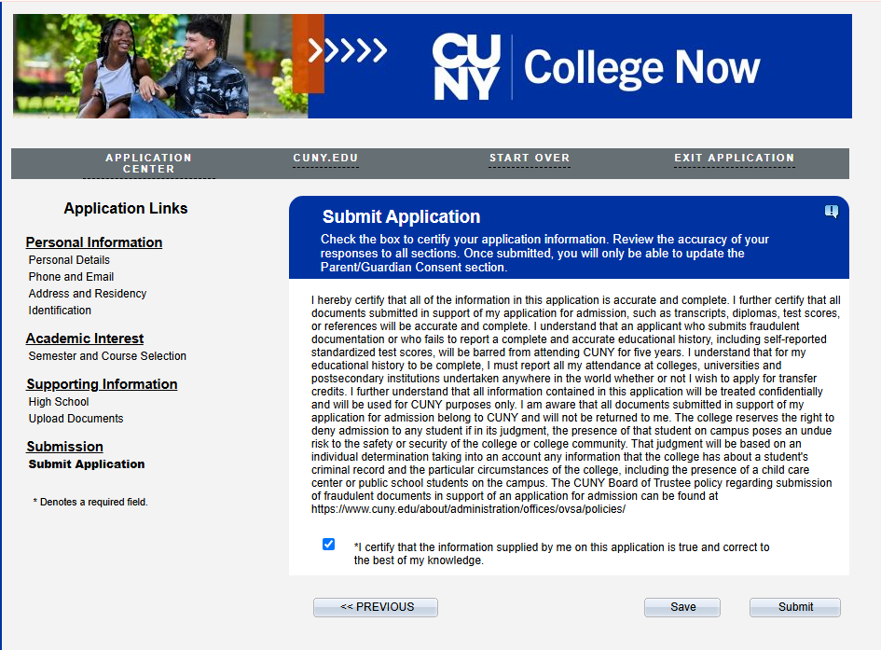
Once Completed, Click “SAVE” and then “SUBMIT”

Slide 23
Once Completed, Click “OK”

Slide 24
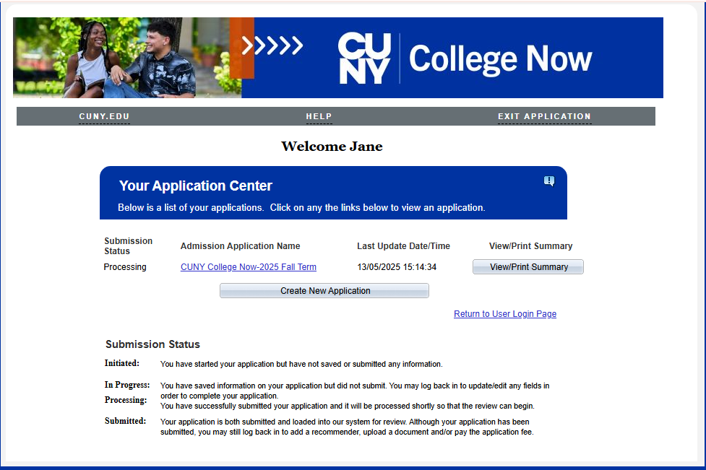
YOUR APPLICATION IS COMPLETED!!!!
CLICK ON VIEW/PRINT SUMMARY
YOUR CUNY EMPL ID will be on the submitted COLLEGE NOW APPLICATION.

Slide 25
DON’T FORGOT TO CLICK “SAVE’’

Slide 26
THANK YOU EVERYONE!!!

