Slide 1

Classroom Podium Tutorial
The Academic Computing Center
718-631-6624

Slide 2
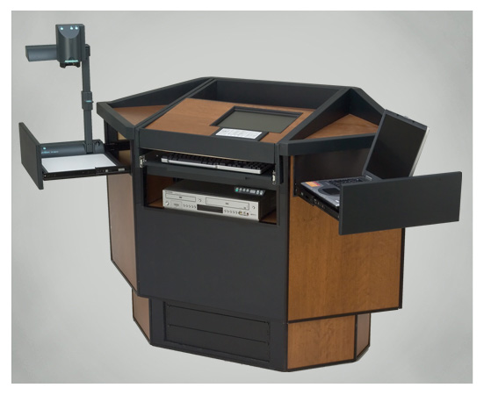
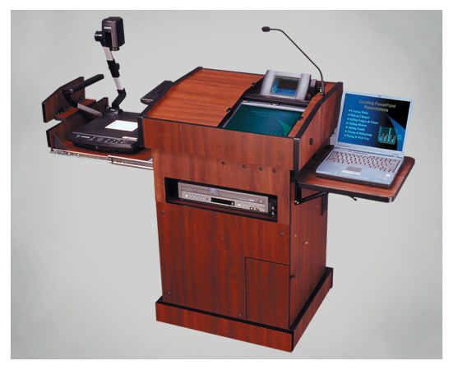
We generally have four podium styles at QCC
  -ADA – Discontinued as of Summer 2016
  -PD Power switch

Slide 3
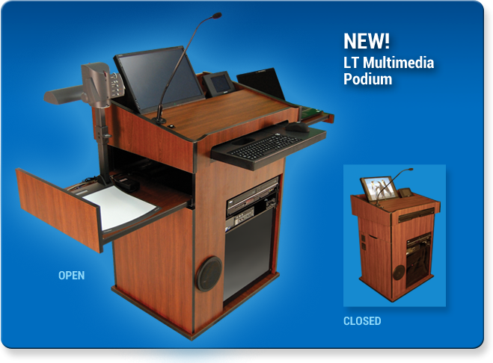

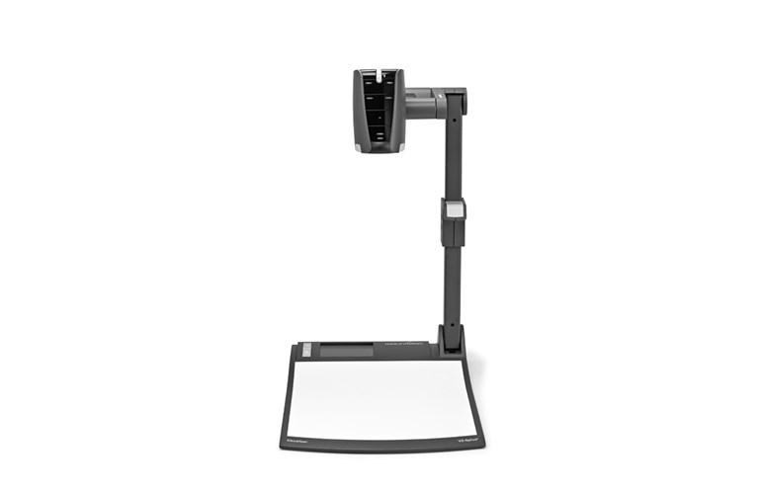
The LT & LTQ are the latest Nomad podia at QCC
  -LT – Has a power switch and WolfVision Doc. Camera
  Power switch

Slide 4
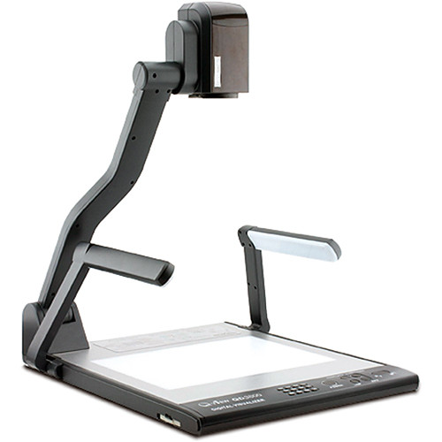
The LT-Q is the second, newer version!
  -LTQ – Doesn’t have a power switch and uses a Qomo Document Camera

Slide 5
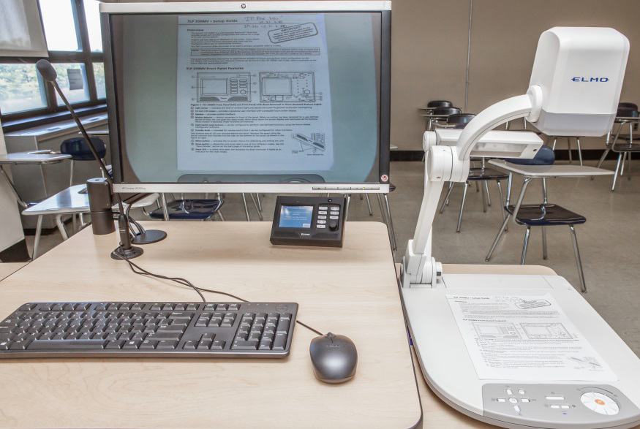
The fourth podium style at QCC
The CP-II features a Computer, Document Camera, BluRay Player, Microphone and VGA/HDMI for your portable devices

Slide 6
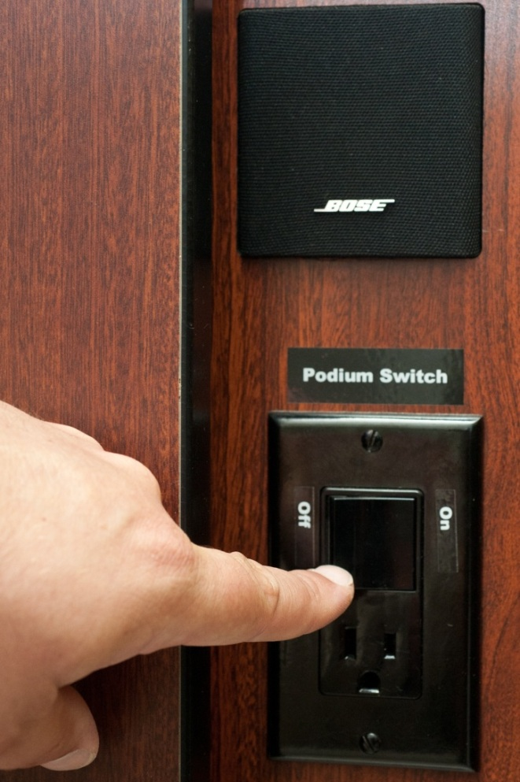
Location of the Nomad Podium Power Switch
You can power on the PD and most LT podia using this switch!

Slide 7
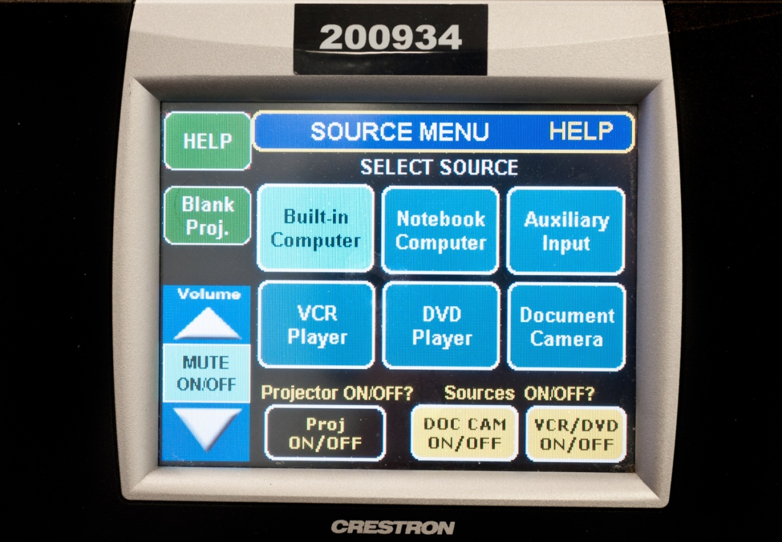
Using the Nomad PD Touch Panel
As shown below, the Crestron Touch Panel is the only means by which you should operate the projector or switch between the PC, your Laptop, Document Camera or DVD/VCR players. Never touch the projector itself!

Slide 8
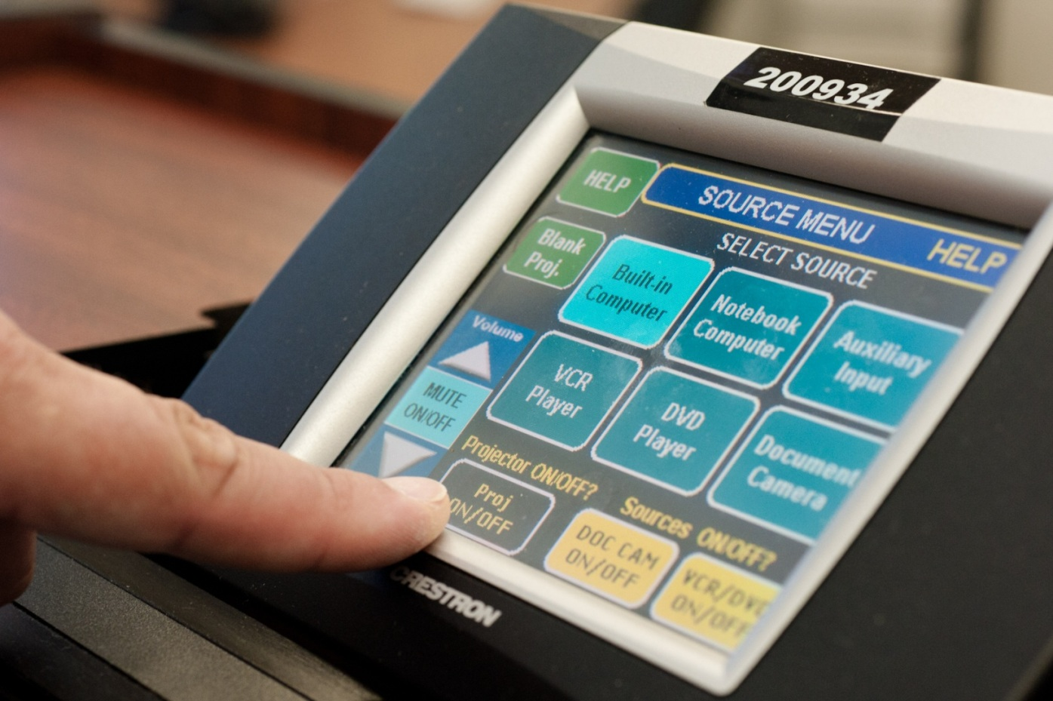
Using the Nomad PD Touch Panel:
Operating the Projector – Turning On or Off
As shown below, you press the Proj On/Off button and the projector will power on in seconds

Slide 9
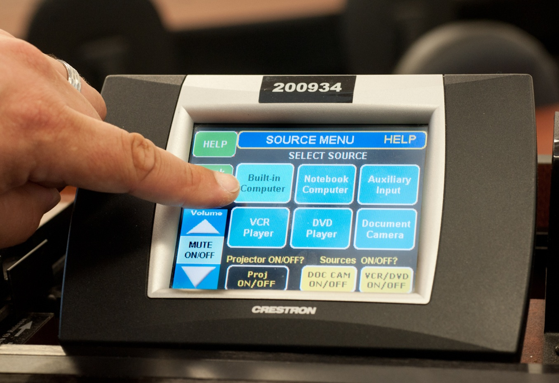
Using the Nomad PD Touch Panel:
Switching to the Podium PC
To display the PC on the projector screen, press the Built-in Computer button as shown below:

Slide 10
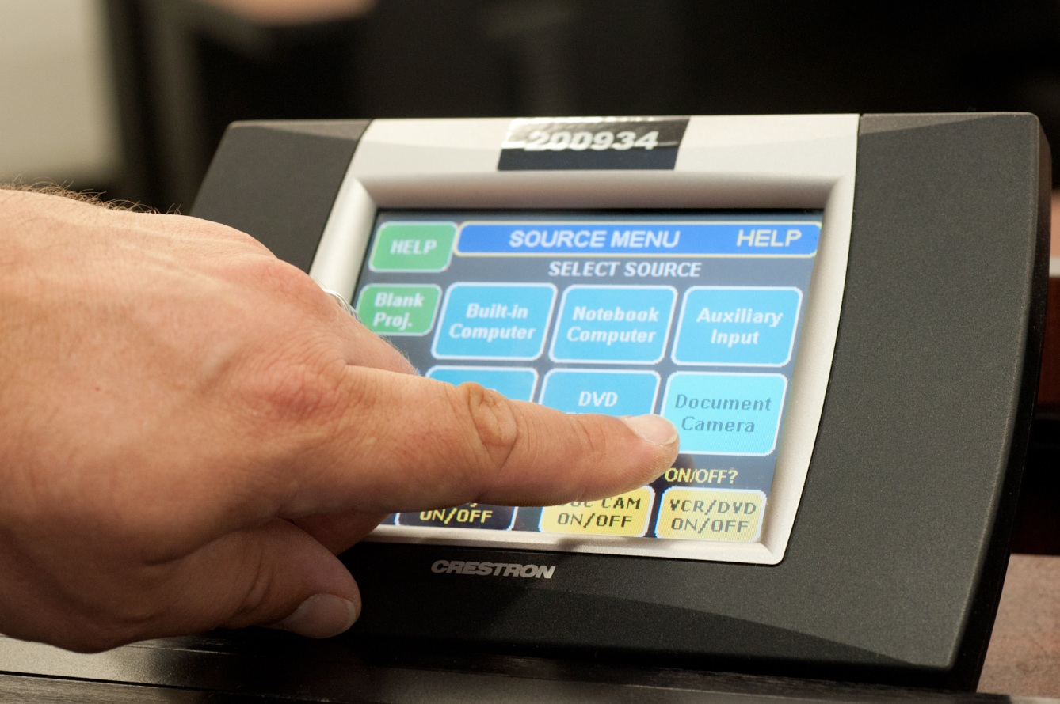
Using the Nomad PD Touch Panel:
Switching to the Document Camera
To switch the Document Camera, just click on the button as shown below:

Slide 11
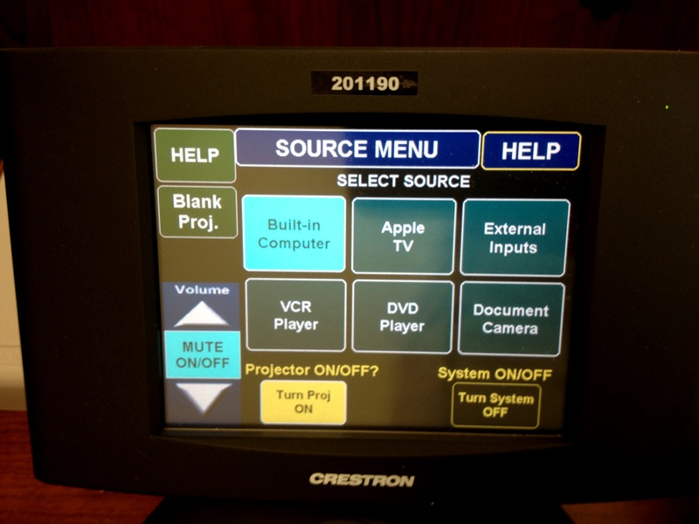
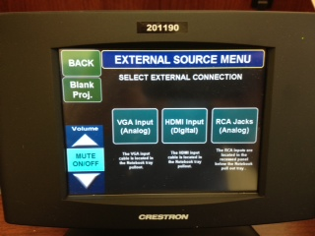
Using the LT Nomad Touch Panel:
Switching to a Laptop or IPad
Functionality is very similar to the PD style panel. However, to display the Laptop on the projector screen, press the External Outputs and then VGA input buttons as shown below:

Slide 12
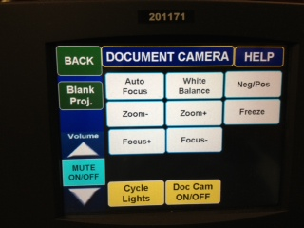
Using the LT Nomad Touch Panel:
Switching to the Document Camera
To display the Document Camera on the projector screen, press the Document Camera button and the Document Camera control menu will appear as shown below:

Slide 13
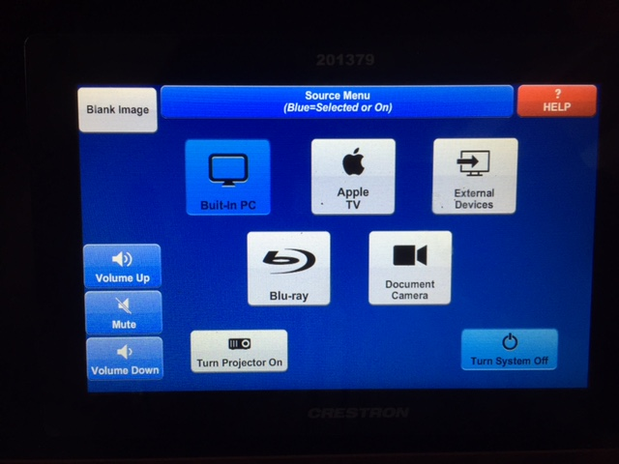
Using the LTQ Crestron Touch Panel:
Power system on and access other functions
For the LTQ series, the power button is on the touch panel itself. Make sure you turn projector off before powering off.

Slide 14
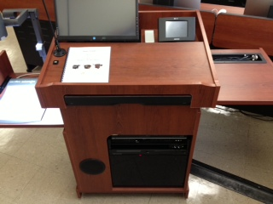
LT and LTQ Podium:
Location of Key Items
LT and LTQ Podia have a PC or Mac Mini. All will have a BLURay or DVD/VCR, Document Camera, and external device tray
Adjustable Monitor with Touch Screen
Crestron Touch Panel
Laptop/iPad Device fold out tray
Document Camera
Keyboard and Mouse fold out tray
DVD/VCR
Computer (PC or Mac)

Slide 15
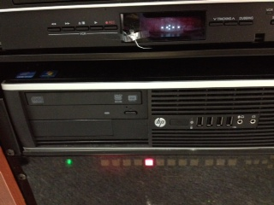
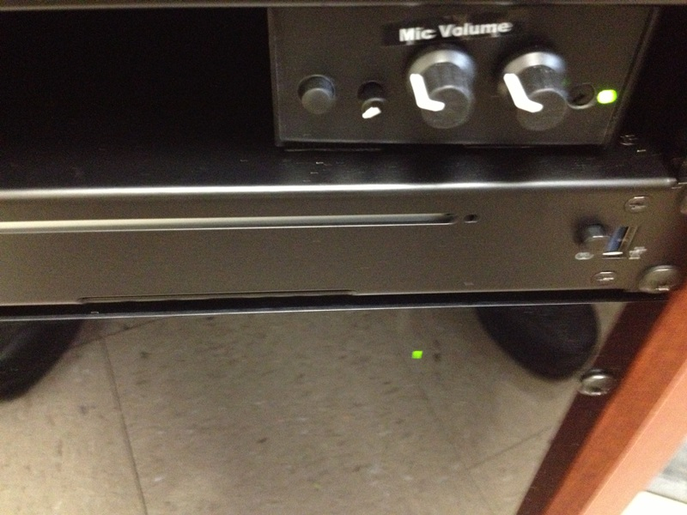

LT and LTQ Podia:
Powering on the Podium PC or Mac Mini
The LT and LTQ Podia can have a PC or Mac in the center of the podium; the power buttons for each are shown below:
PC MAC

Slide 16
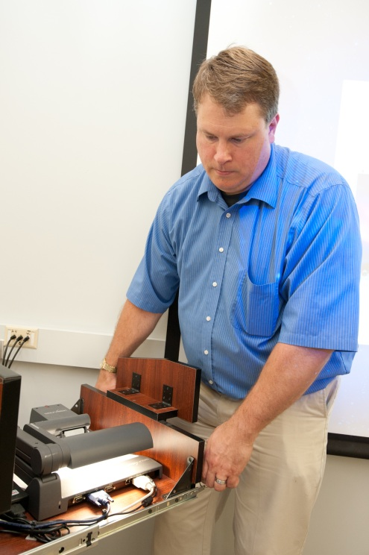
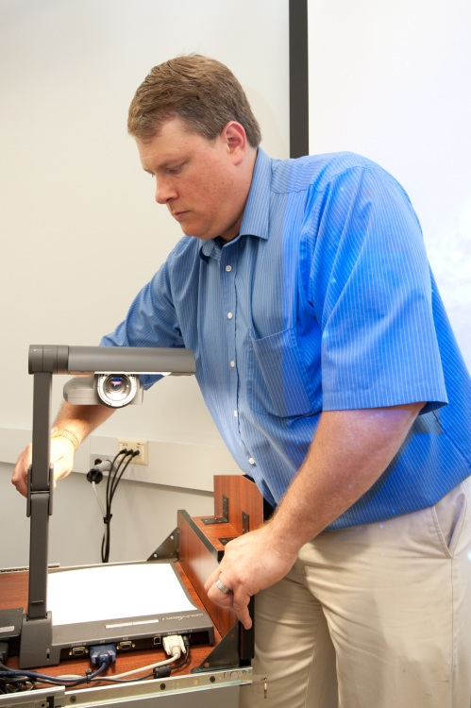
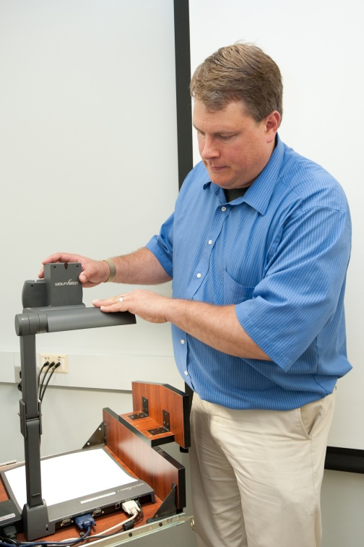
Using the Nomad Document Camera:
Pulling out the camera and setting up
As shown below, the following is a step by step on how to setup the camera:

Slide 17
The CP-II podium
The CP-II features a Computer, Document Camera, BluRay Player, Microphone and VGA/HDMI for your portable devices

Slide 18
The CP-II is our newest podium!
Features:
  Built-in PC,
  Elmo Document Camera,
  BluRay Player,
  Annotation capability,
  Shure Gooseneck Microphone
  VGA/HDMI connections for your portable devices

Slide 19
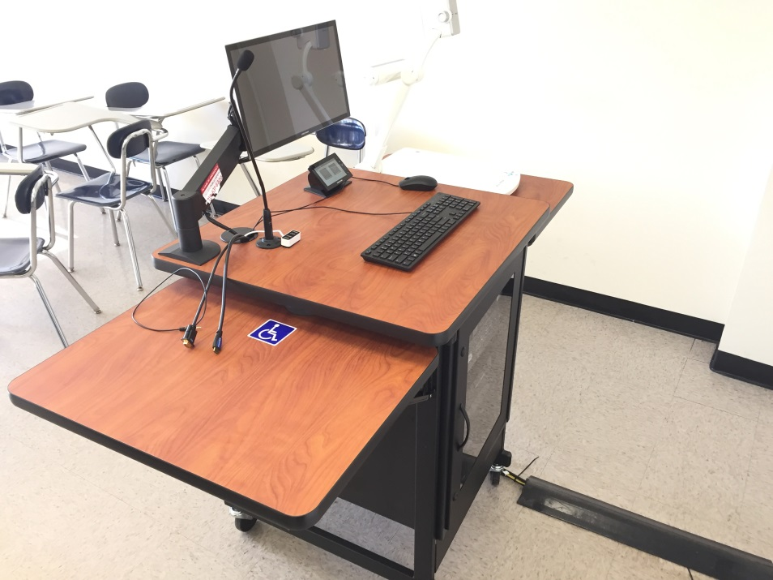
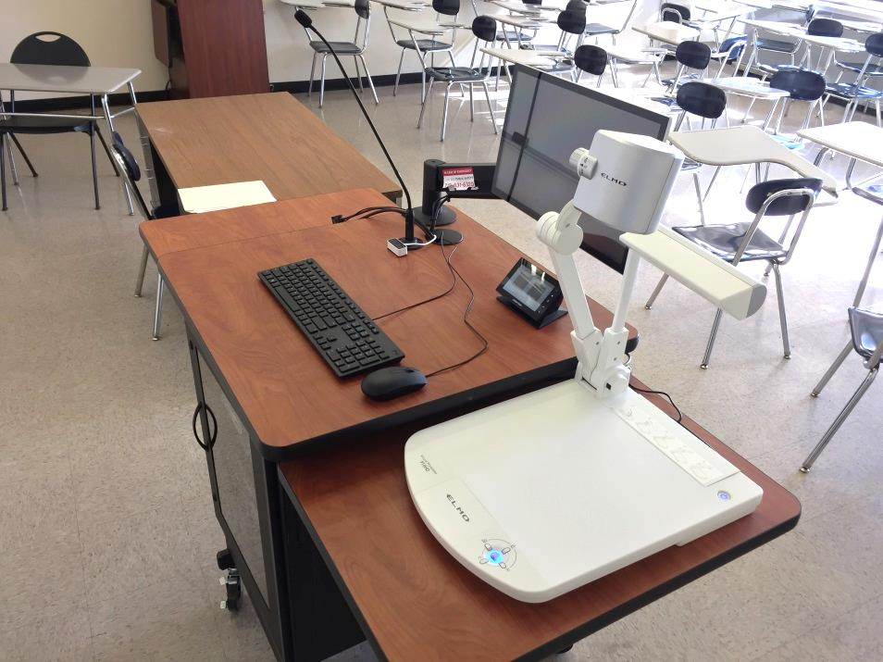
The CP-II features ample desk space!

Slide 20
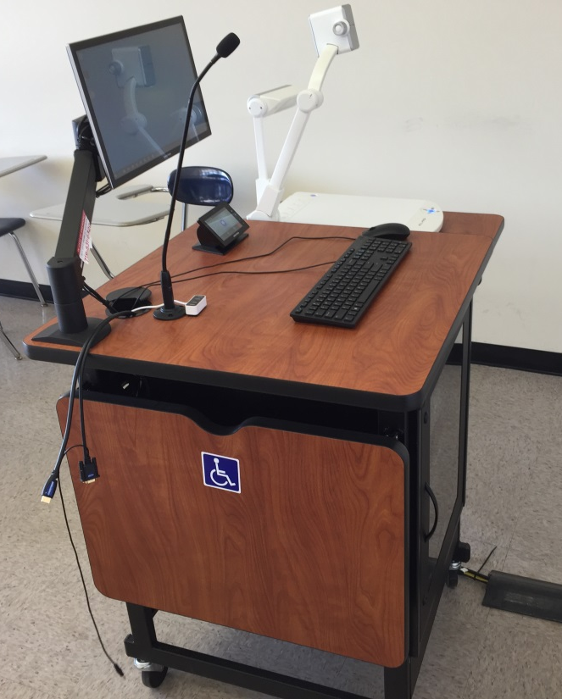
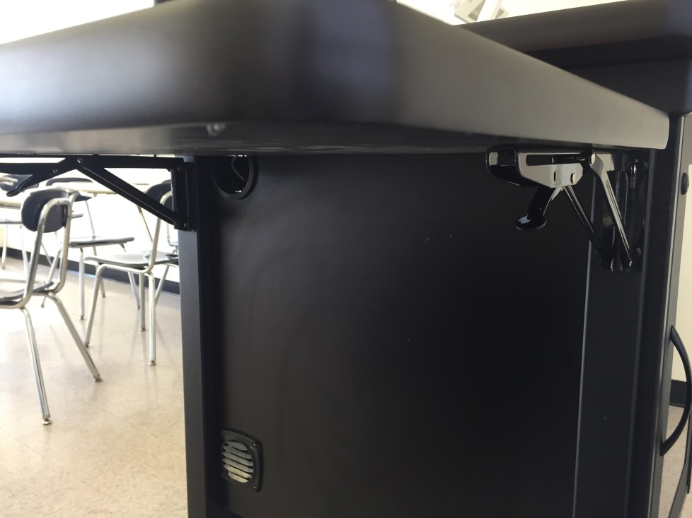
The CP-II is our newest podium!
The podium has a folding table top that you can fold down using levers circled below; *it is always opposite doc cam which is on a fixed shelf.

Slide 21
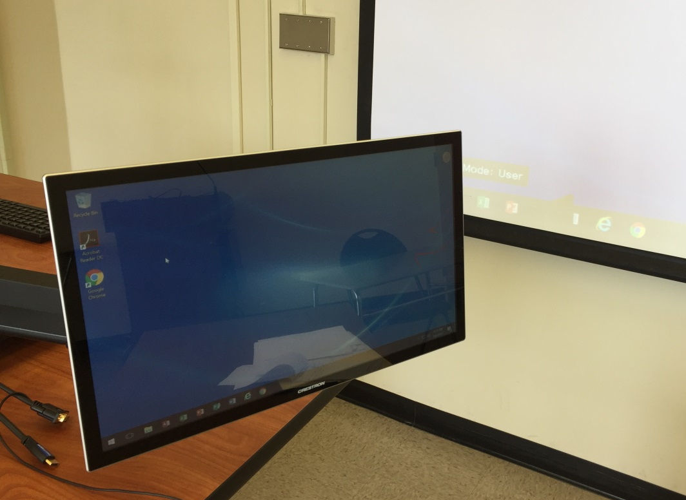
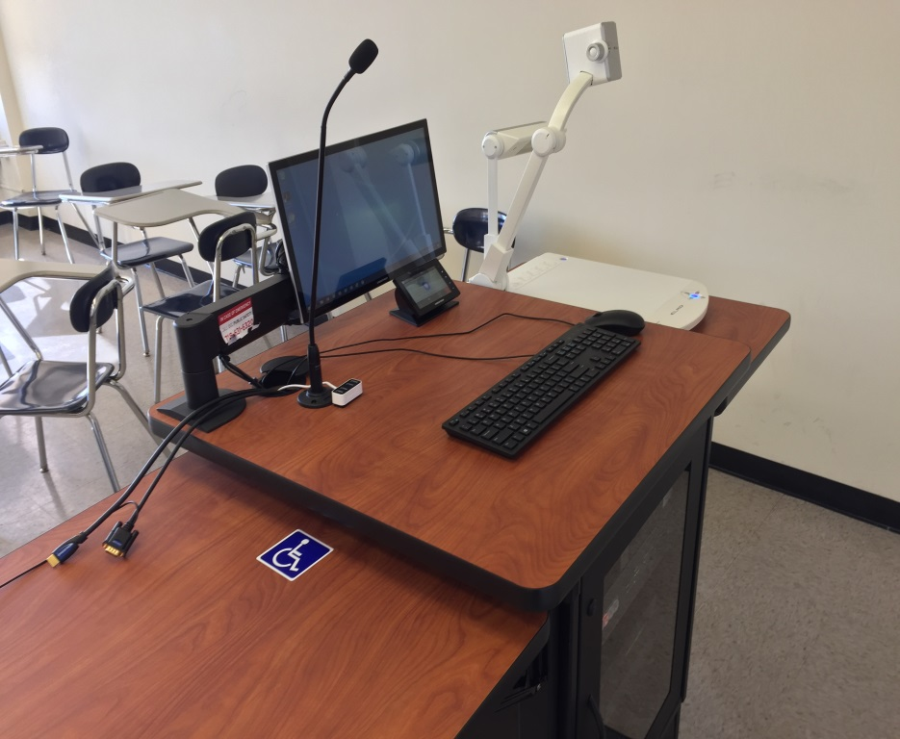
The CP-II is our newest podium!
The podium has a confidence monitor that can easily be moved around for your convenience.

Slide 22
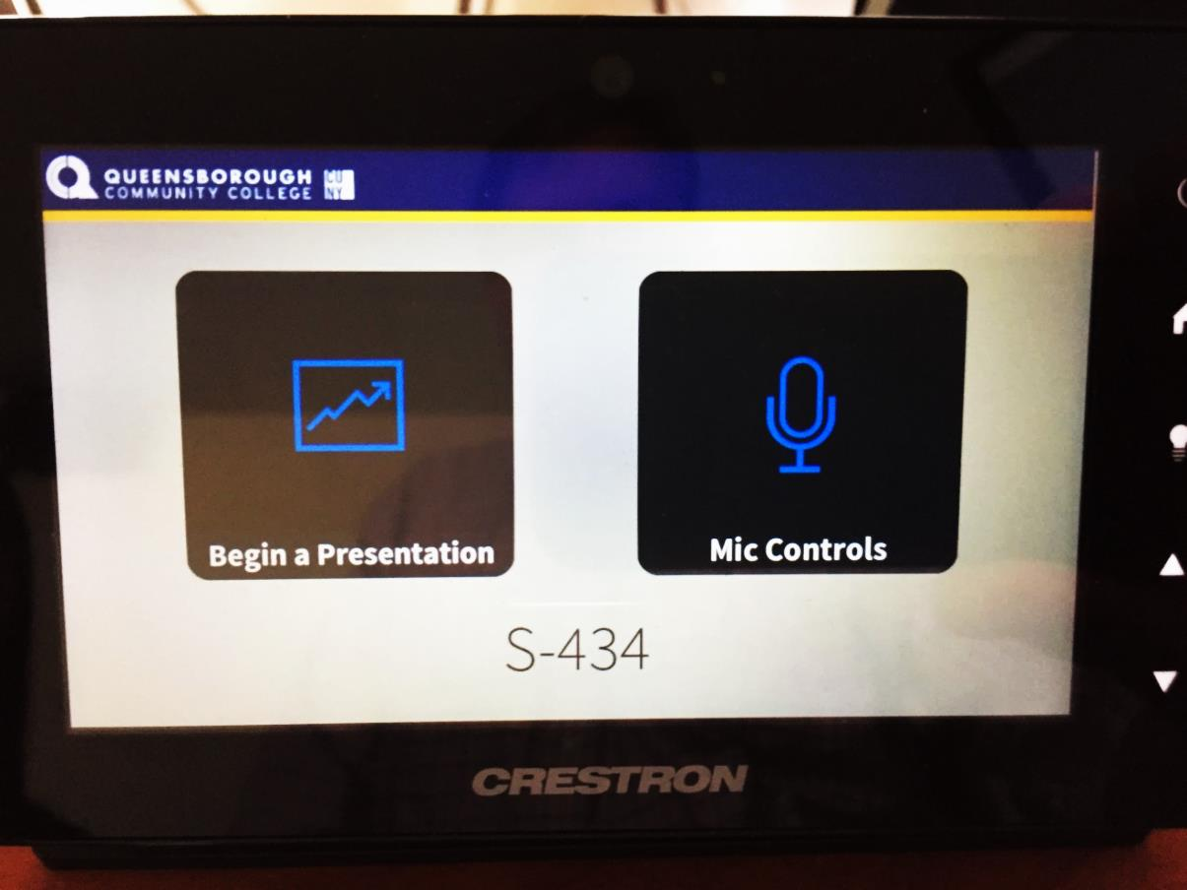
CP-II Podium Training
Using the Touch Panel
As shown below, the Touch Panel is the only means by which you should operate the projector or switch between the PC, your Laptop, Document Camera or DVD/VCR players. Never touch the projector itself!

Slide 23
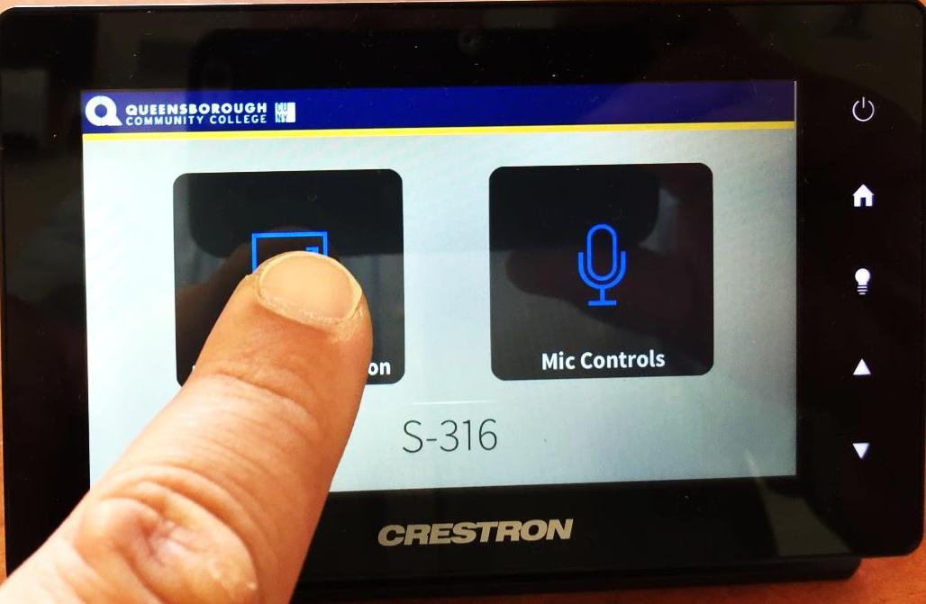
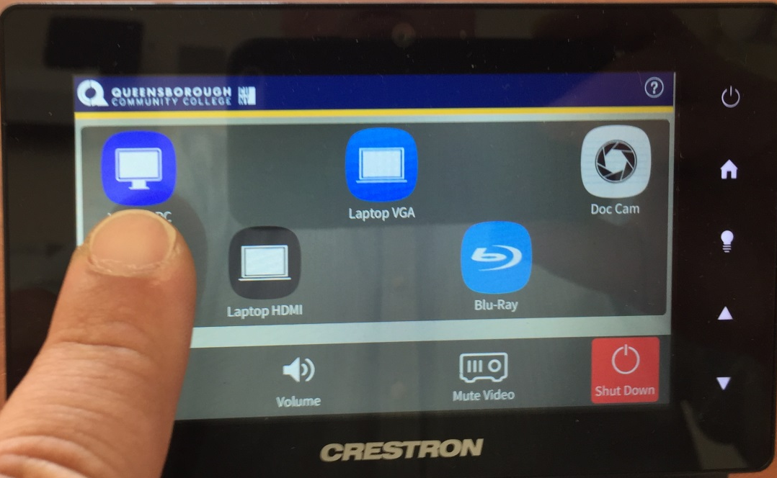
CP-II Podium Training
Using the Touch Panel
To begin, press “Begin a Presentation” and then press the source you wish to use. In this example we are selecting the Lectern PC:

Slide 24
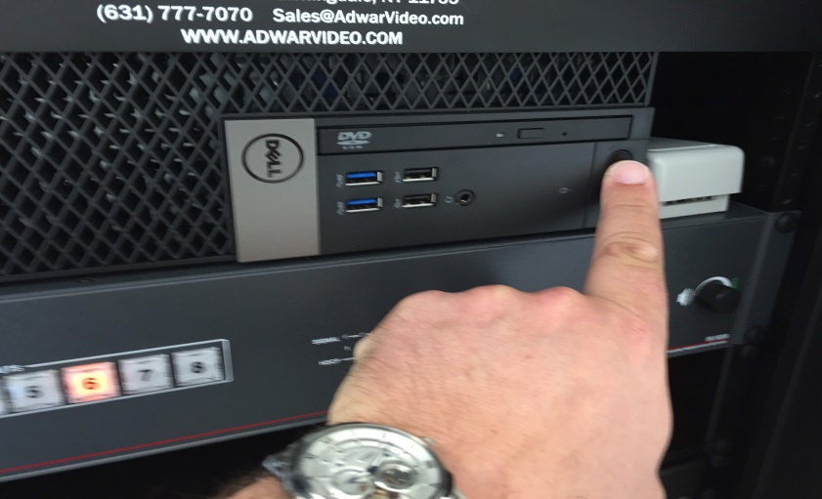
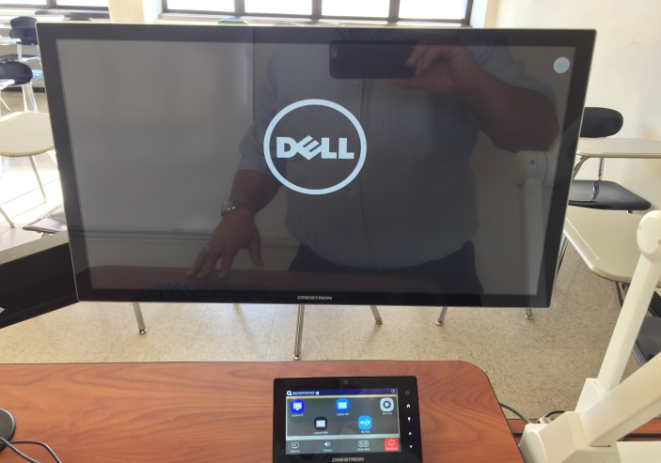
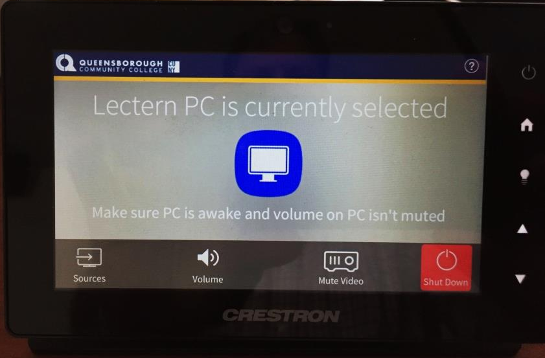
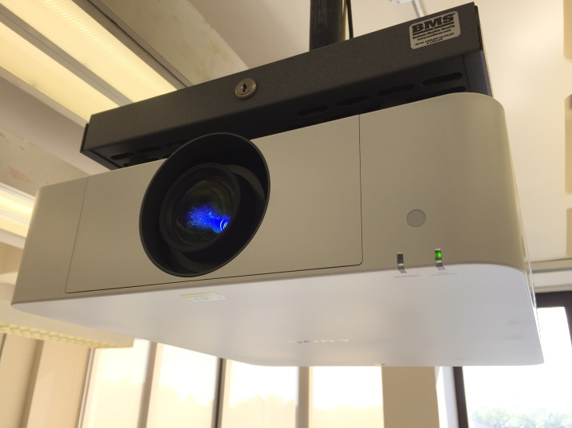
CP-II Podium Training
Using the Lectern PC
Turn on the PC as shown below, you should see monitor with the Dell logo, the projector turn on and the touch panel displaying the selected source:

Slide 25
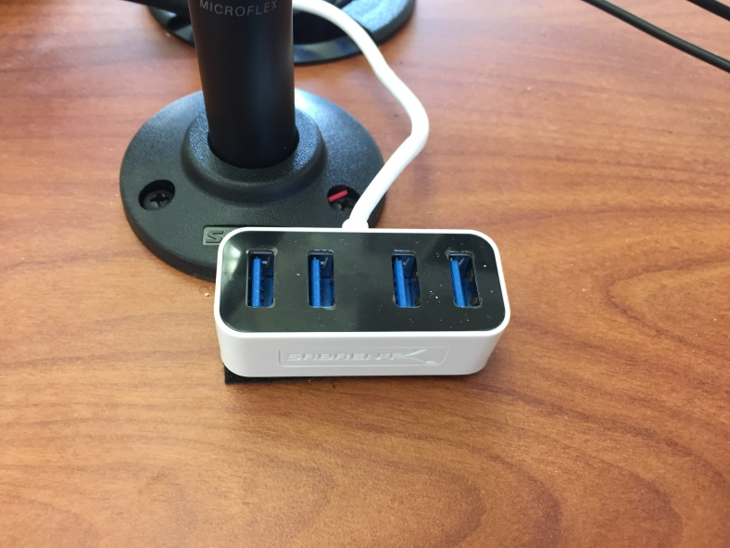

CP-II Podium Training
Using the Lectern PC
The PC has 4 built in USB slots, though a more convenient 4 port USB hub is provided as shown below:

Slide 26
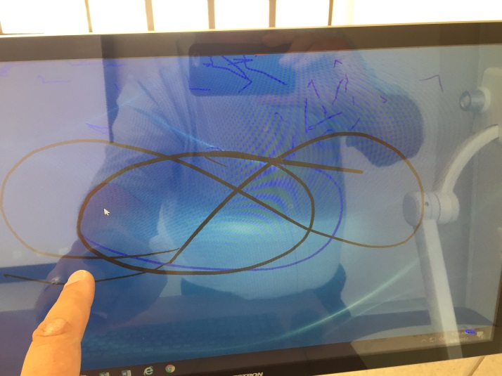
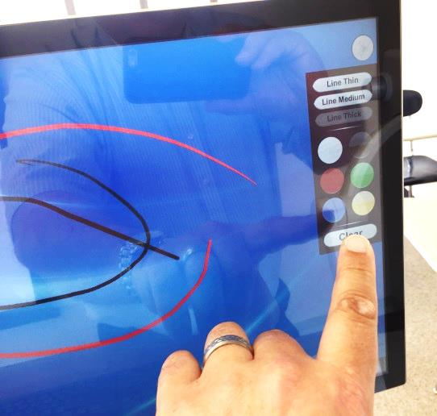
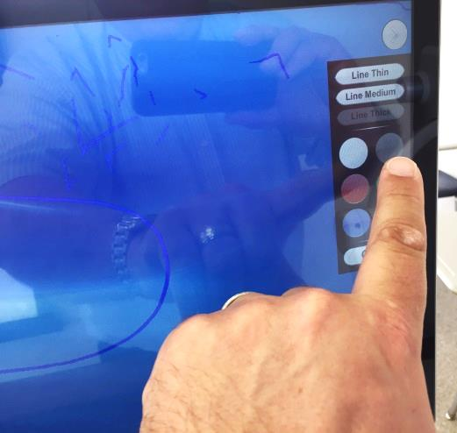
CP-II Podium Training
Using Built-in Annotation
The confidence monitor touch screen allows you to annotate over any selected source. There is a grey button that provides a menu where you can select color and line thickness, as well as, clear all screen annotation. Clicking the grey button will hide the menu and you can use your finger to draw on the screen:

Slide 27
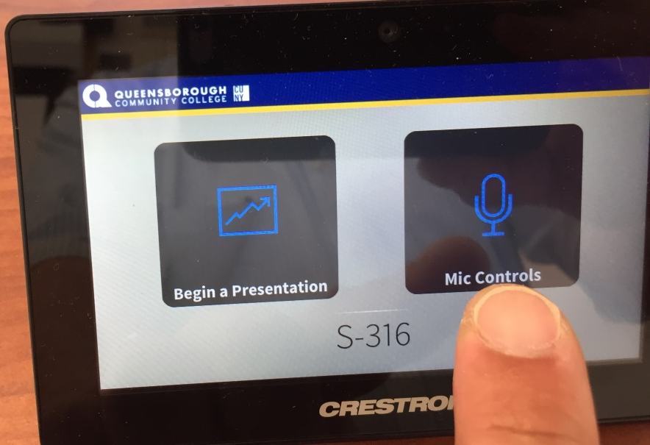
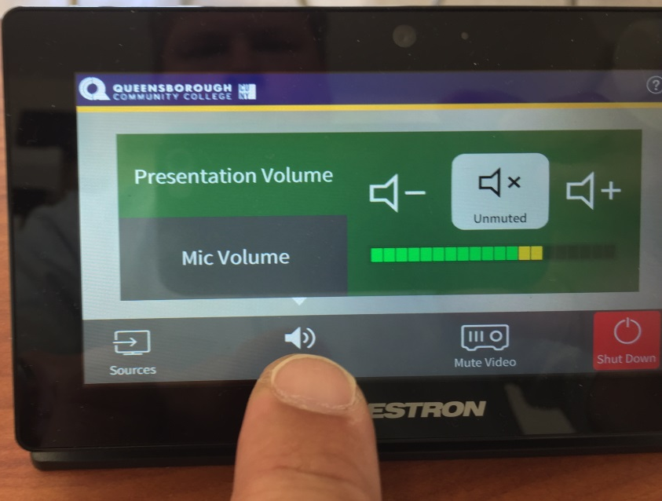
CP-II Podium Training
Controlling Audio for Source and Microphone
Upon startup the audio controls will automatically be set to a default level for the active source and the podium microphone.

Slide 28
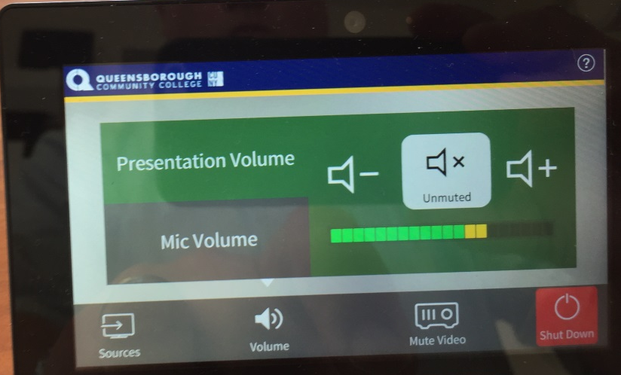
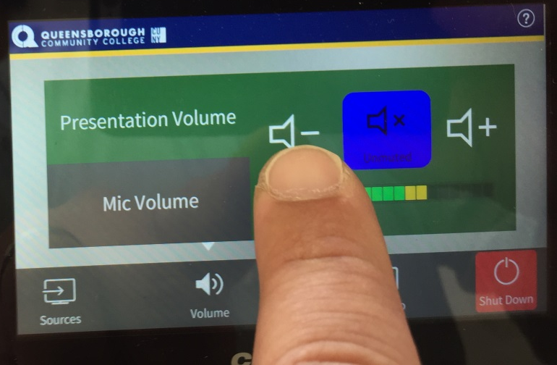
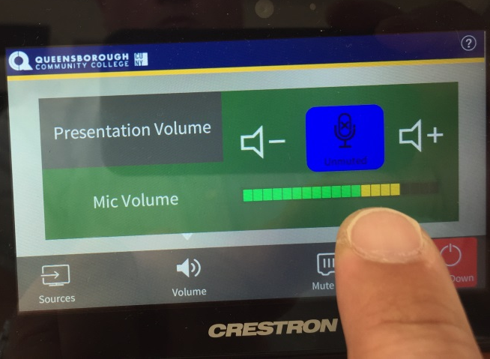
CP-II Podium Training
Controlling Audio for Source and Microphone
You can mute, as well as, adjust audio levels for active presentation source or microphone as shown below. Note: volume button will toggle to blue when muted and grey when not.

Slide 29
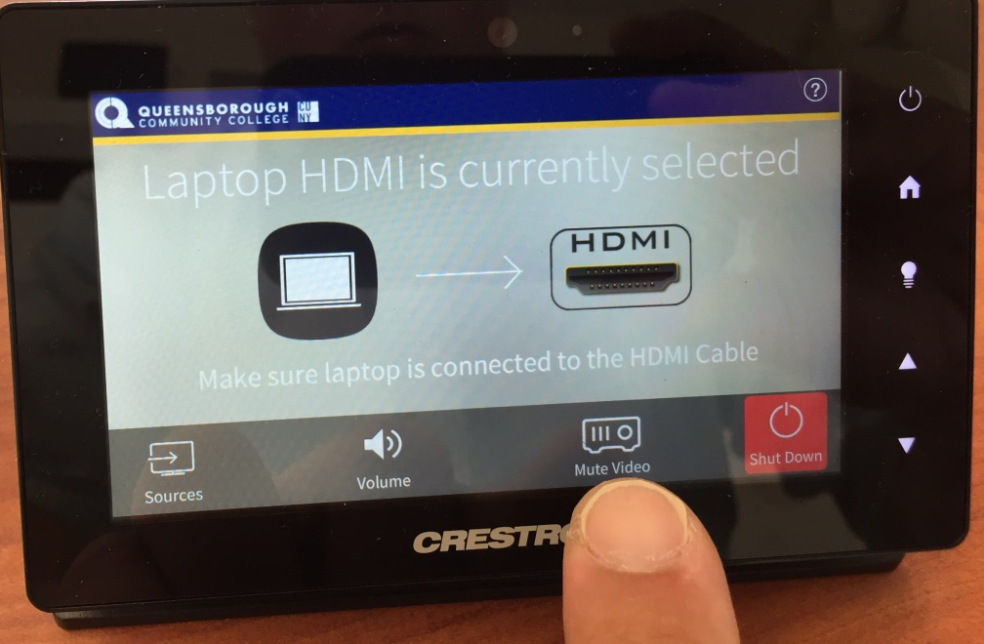
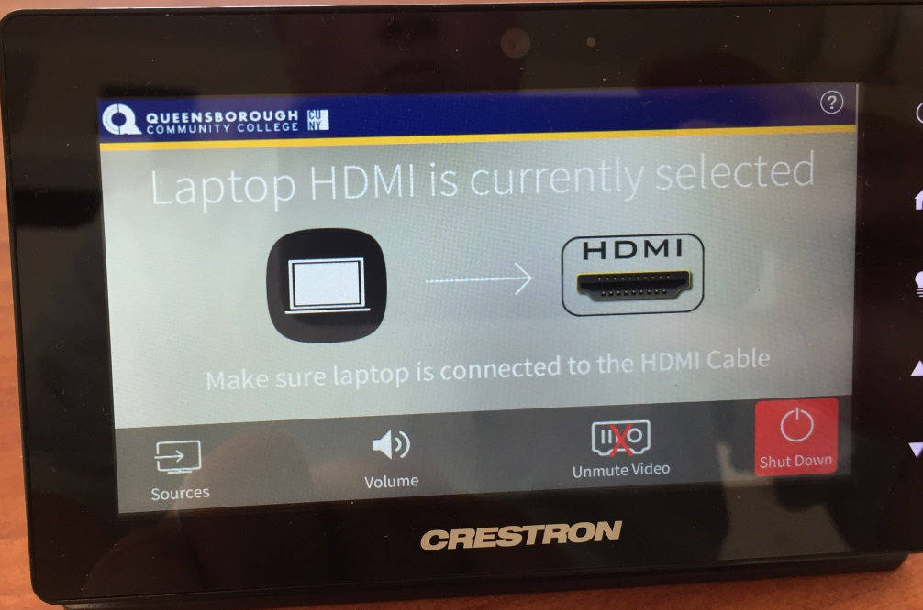
CP-II Podium Training
Mute the Projector
You can mute the projector image so your class cannot see what you have on your screen by pressing the “Mute Video” icon as shown below. You can un-mute, by pressing the button again. A red X will appear over the icon when muted.

Slide 30
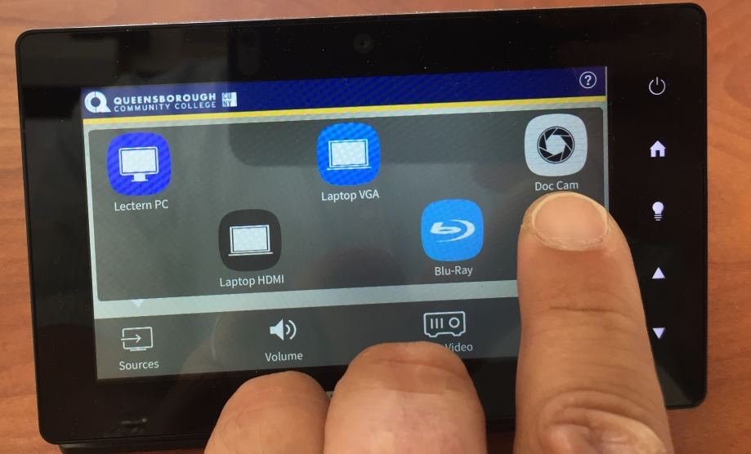
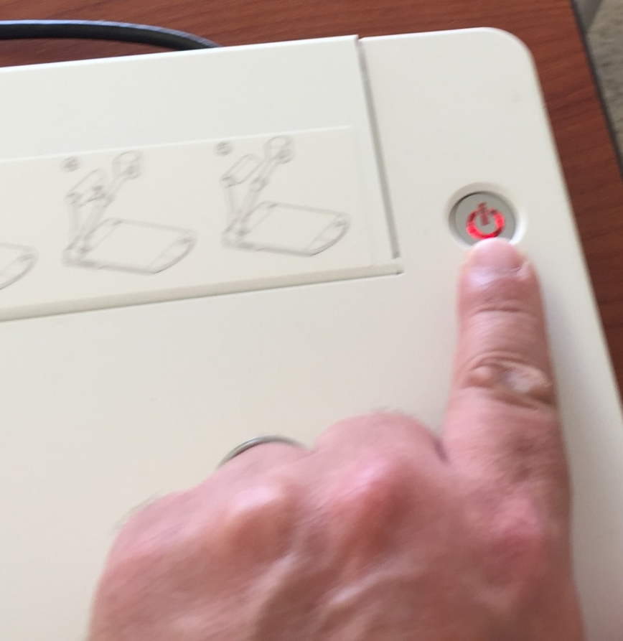
CP-II Podium Training
Using the Document Camera
To use the document camera, select “Doc Cam” from touch panel, hold down the power button for 4 seconds to power on the Elmo unit.

Slide 31
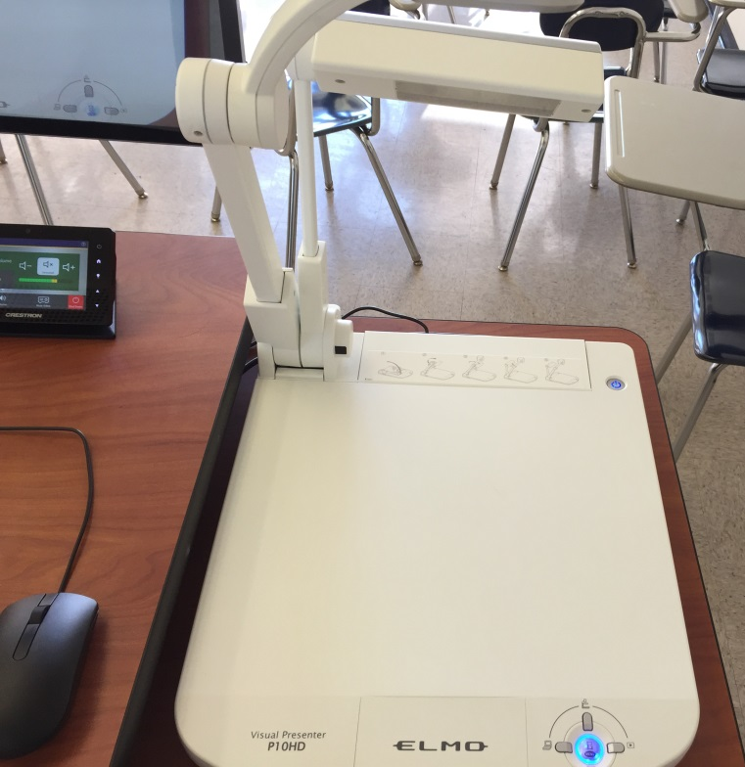
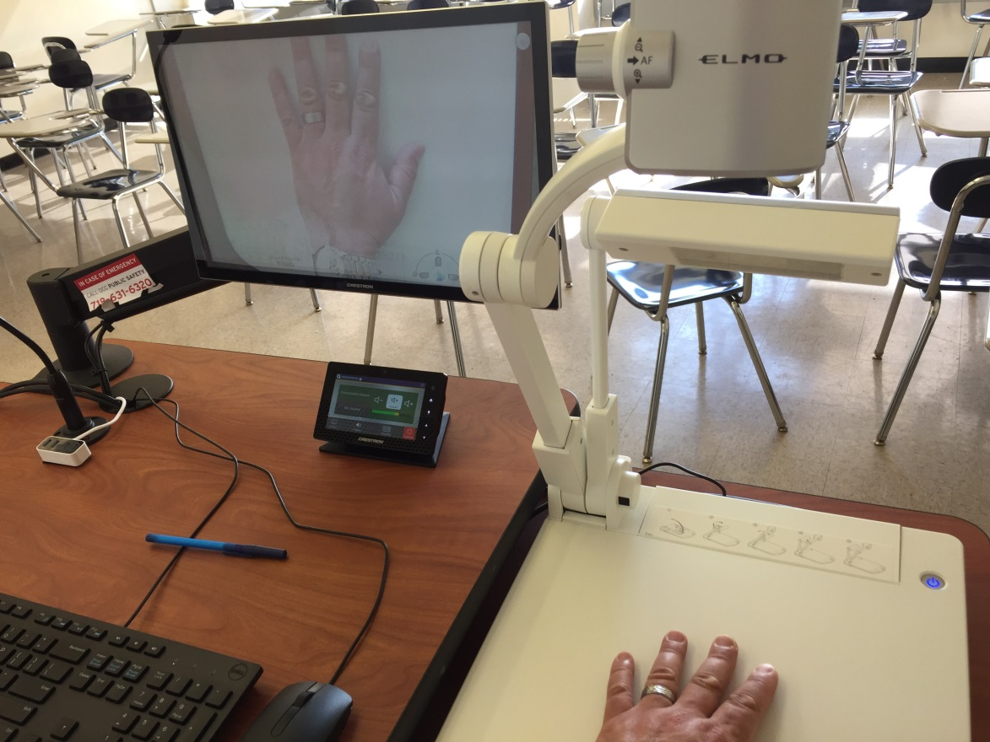
CP-II Podium Training
Using the Document Camera
The document camera will show a blue light and image will appear on the confidence monitor.

Slide 32
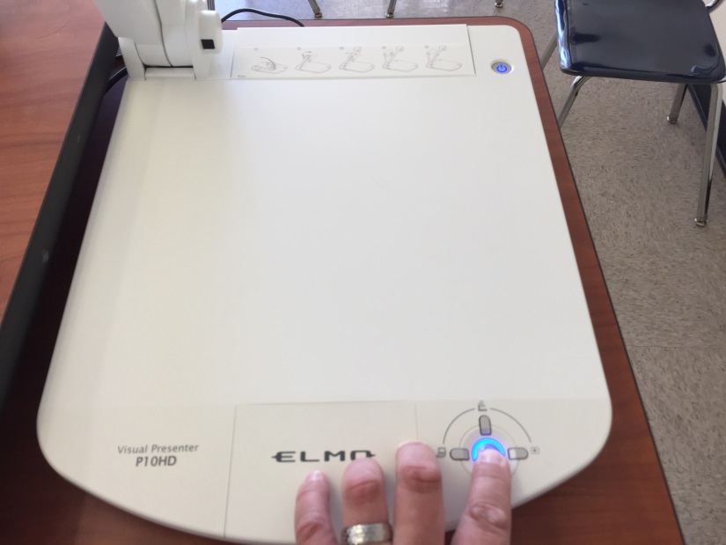

CP-II Podium Training
Using the Document Camera
To freeze the document camera image press the menu button and left key to navigate and select the Pause (hour glass) function as shown, press menu to engage and then click again to exit to Live mode.

Slide 33

CP-II Podium Training
Using the Document Camera
You can adjust zoom level by using the wheel control on top of the camera or through the menu button

Slide 34


CP-II Podium Training
Using the Blu-Ray Player
Select Blu-Ray from the touch panel and in podium cabinet, click on eject button to insert DVD/Blu-Ray media. You can operate player using controls on the touch panel.

Slide 35

CP-II Podium Training
Using the Blu-Ray Player
Once you’ve selected Blu-Ray button on the touch panel the Blu-Ray submenu will appear where you can operate using buttons as shown.

Slide 36


CP-II Podium Training
Using Own Laptop, MacBook or Other Device
If you have a laptop, iPad or MacBook with appropriate adaptor you can use either HDMI or VGA cables provided and then select either Laptop VGA or Laptop HDMI button.

Slide 37


CP-II Podium Training
Shutting Down the Projector
When you are finished with your presentation, choose the “Shut Down” button and then choose again to confirm. This will turn off the projector, but will leave all other equipment operational.
Make sure you take your flash drive and log out of personal accounts before you leave!

Slide 38
CP-II Podium Training
Thank you!!!
For Questions and Help
Please contact the Academic Computing Center
  By Phone at 718-631-6624
  Or Email Mark Chropufka, Academic Technology Director, mchropufka@qcc.cuny.edu

