Slide 1

CP-II Podium Tutorial
The Academic Computing Center
718-631-6624

Slide 2
The CP-II is our newest podium!
Features:
  Built-in PC,
  Elmo Document Camera,
  BluRay Player,
  Annotation capability,
  Shure Gooseneck Microphone
  VGA/HDMI connections for your portable devices

Slide 3
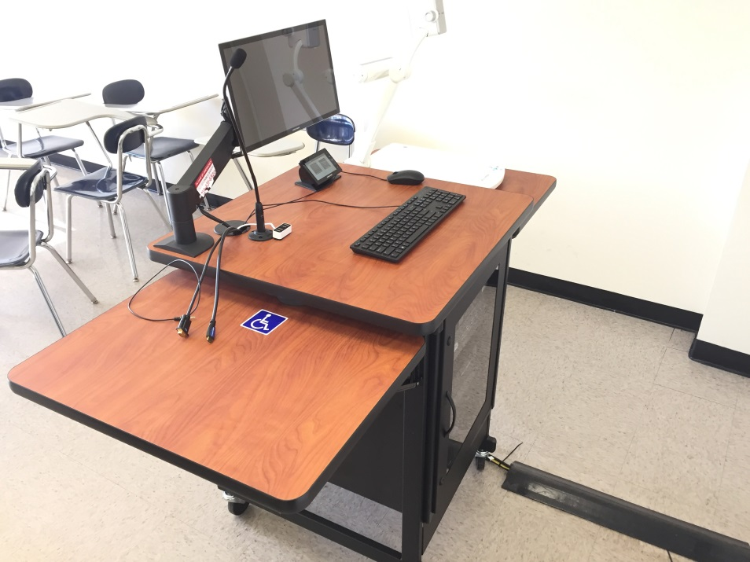
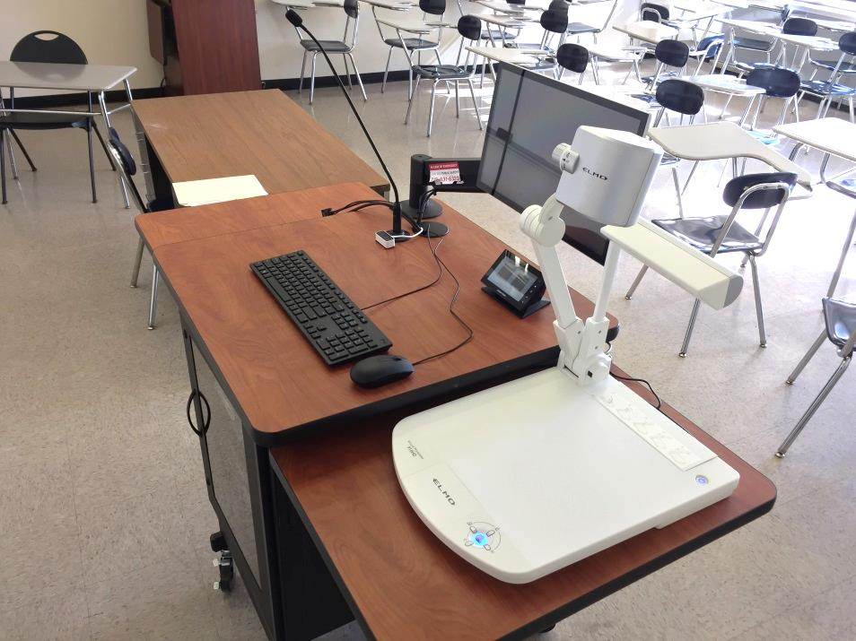
The CP-II features ample desk space!

Slide 4
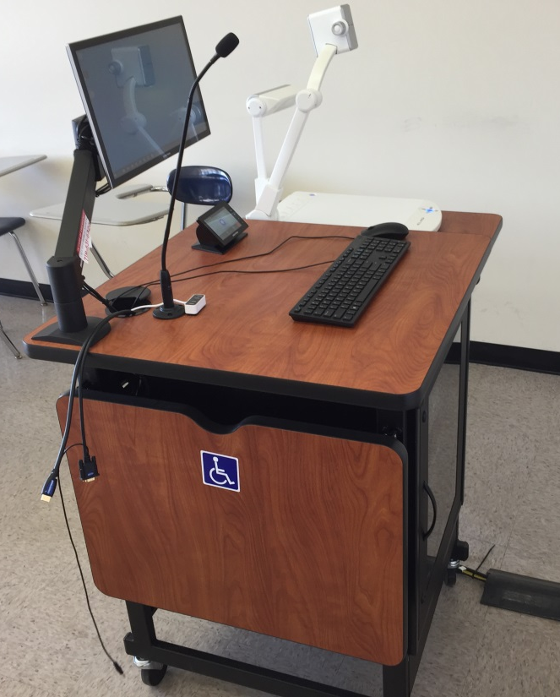
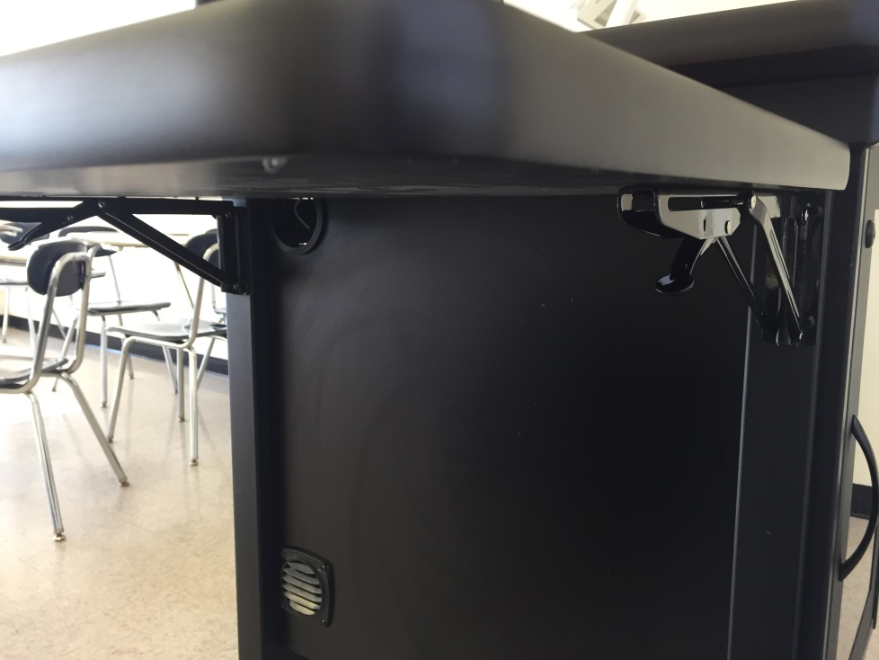
The CP-II is our newest podium!
The podium has a folding table top that you can fold down using levers circled below; *it is always opposite doc cam which is on a fixed shelf.

Slide 5
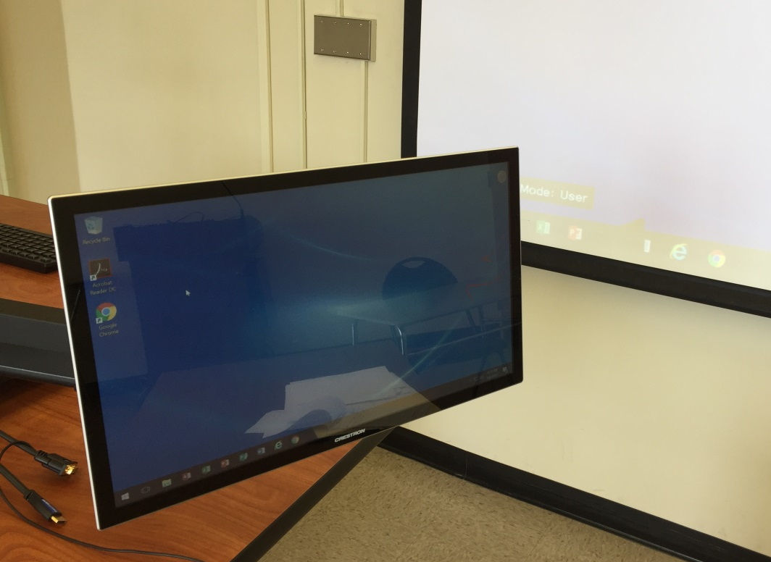
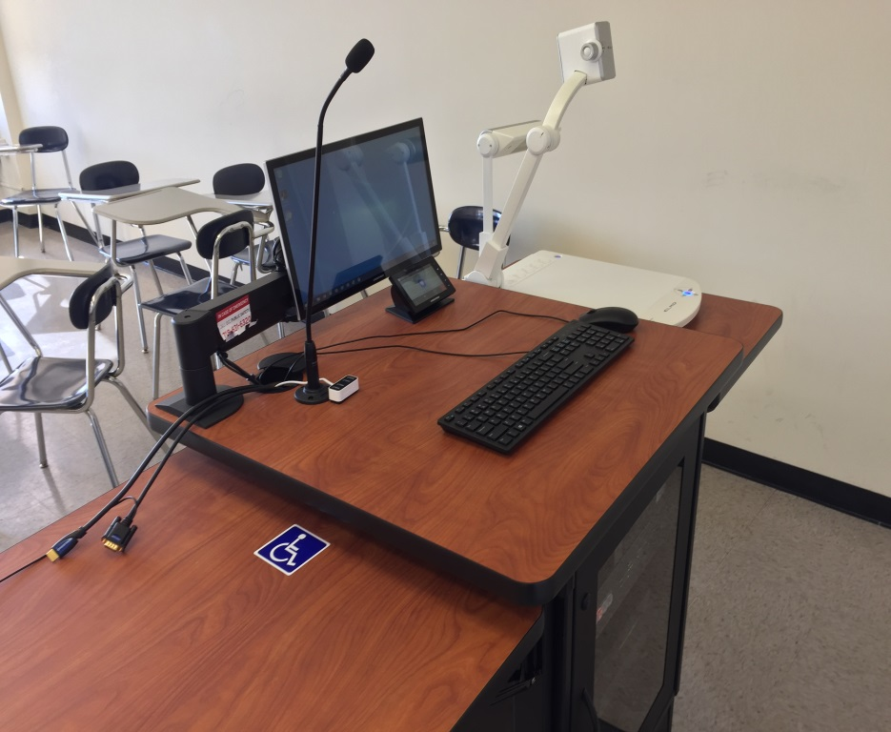
The CP-II is our newest podium!
The podium has a confidence monitor that can easily be moved around for your convenience.

Slide 6
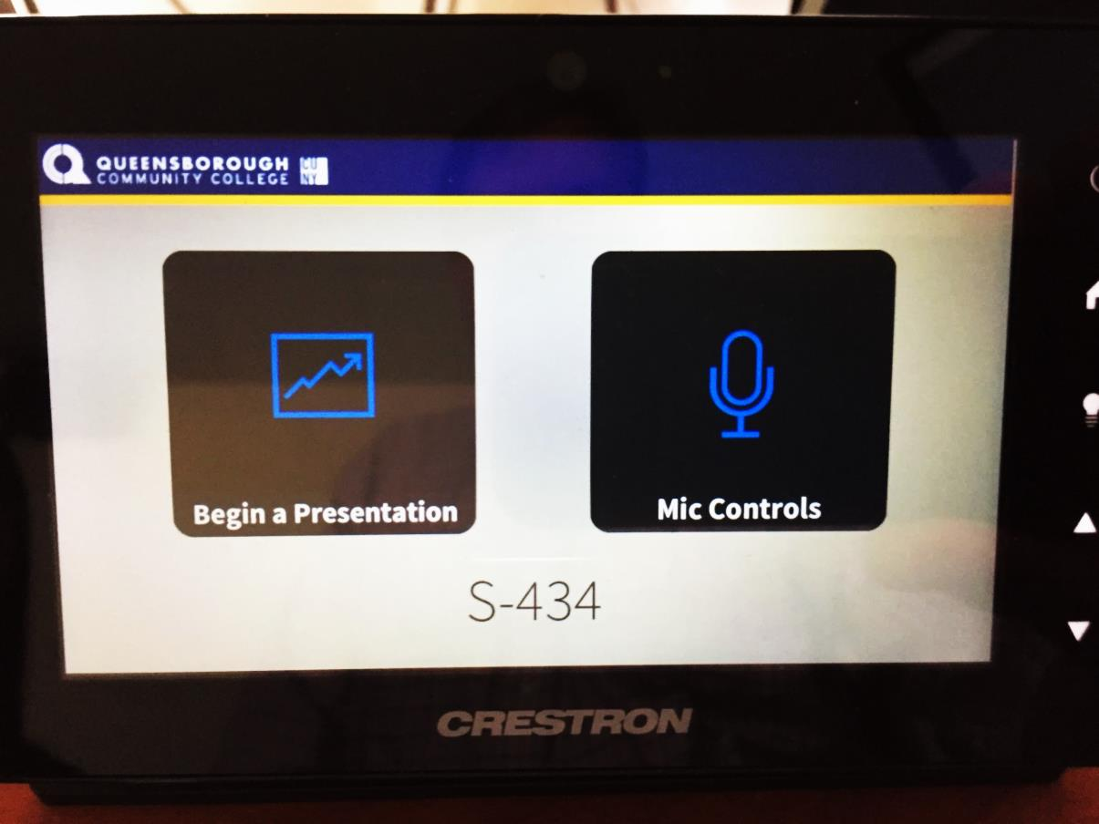
CP-II Podium Training
Using the Touch Panel
As shown below, the Touch Panel is the only means by which you should operate the projector or switch between the PC, your Laptop, Document Camera or DVD/VCR players. Never touch the projector itself!

Slide 7
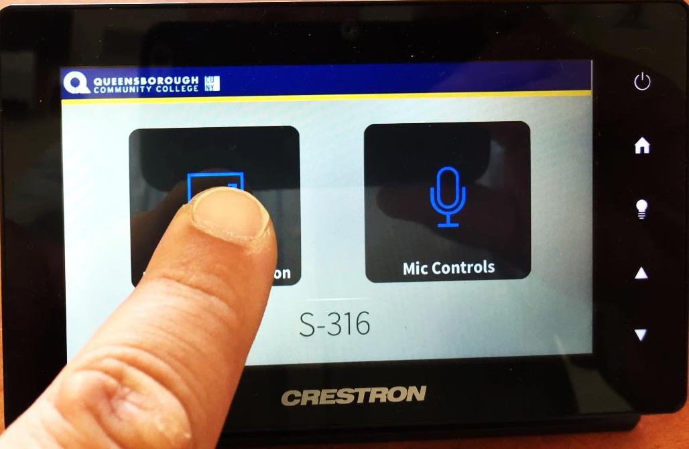
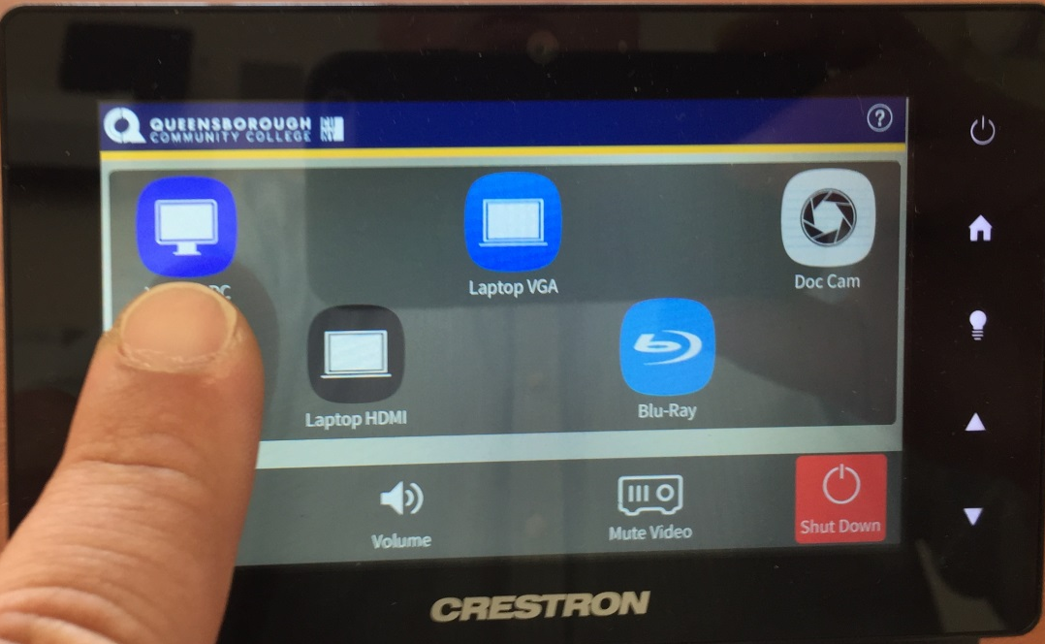
CP-II Podium Training
Using the Touch Panel
To begin, press “Begin a Presentation” and then press the source you wish to use. In this example we are selecting the Lectern PC:

Slide 8
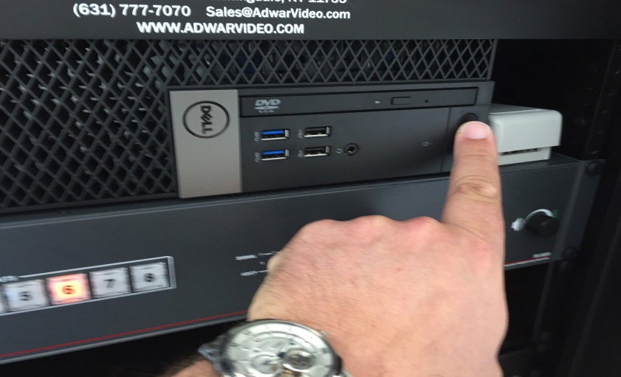
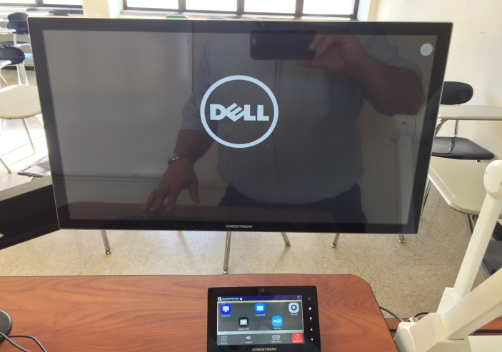
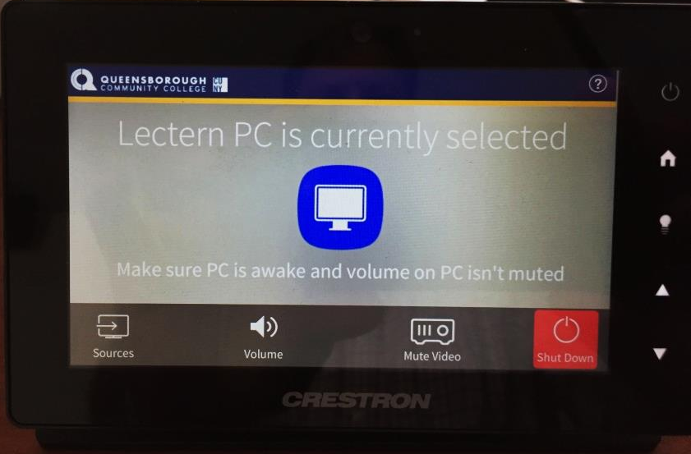
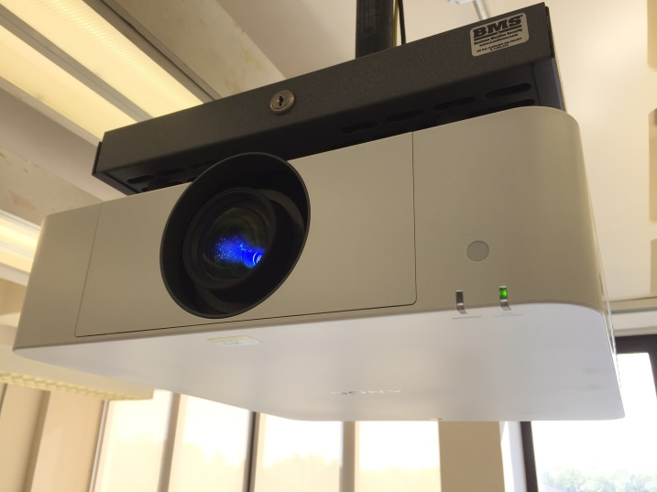
CP-II Podium Training
Using the Lectern PC
Turn on the PC as shown below, you should see monitor with the Dell logo, the projector turn on and the touch panel displaying the selected source:

Slide 9
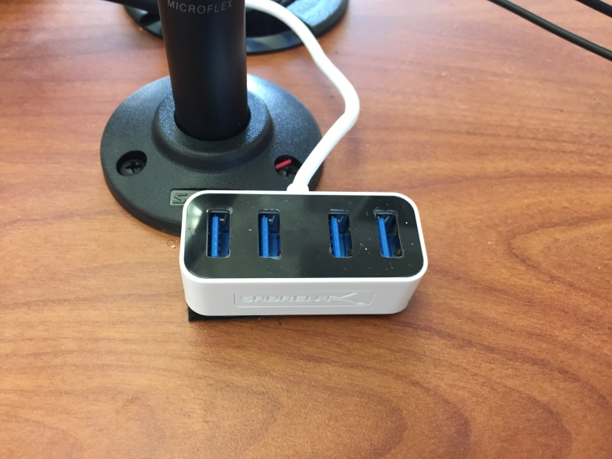

CP-II Podium Training
Using the Lectern PC
The PC has 4 built in USB slots, though a more convenient 4 port USB hub is provided as shown below:

Slide 10
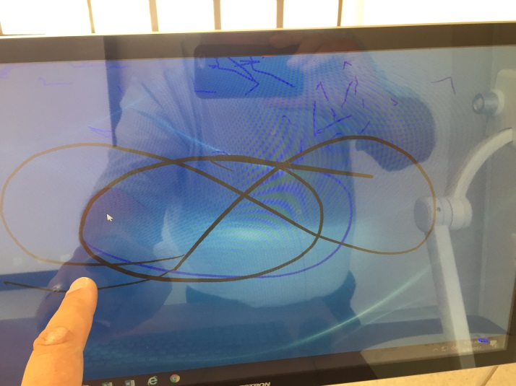
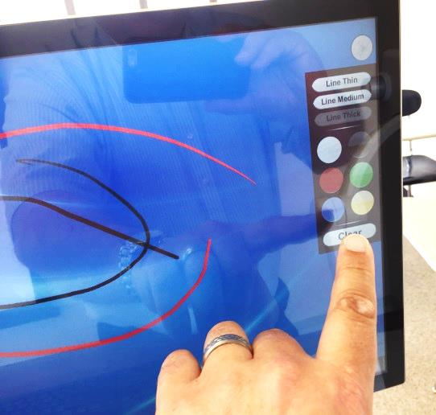
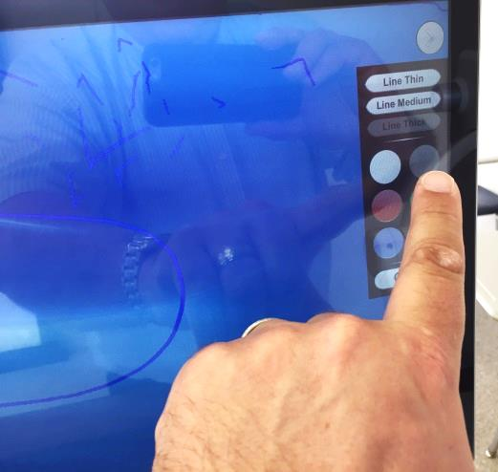
CP-II Podium Training
Using Built-in Annotation
The confidence monitor touch screen allows you to annotate over any selected source. There is a grey button that provides a menu where you can select color and line thickness, as well as, clear all screen annotation. Clicking the grey button will hide the menu and you can use your finger to draw on the screen:

Slide 11
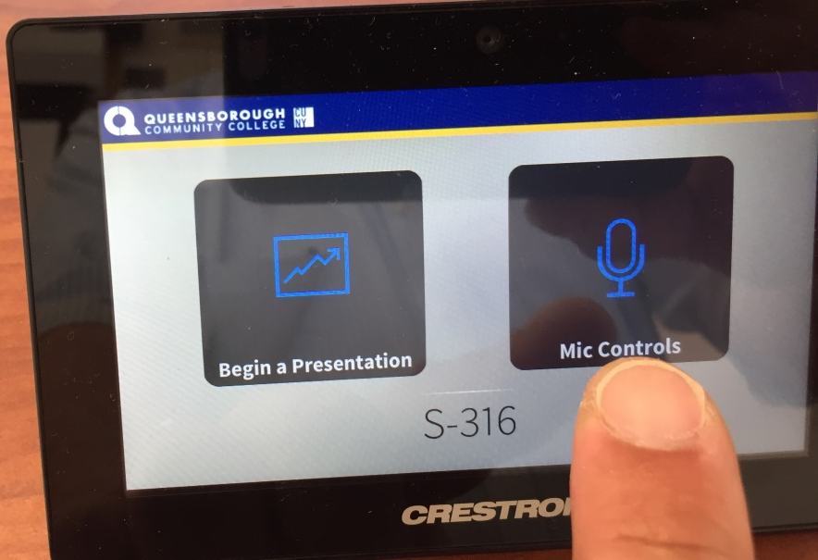
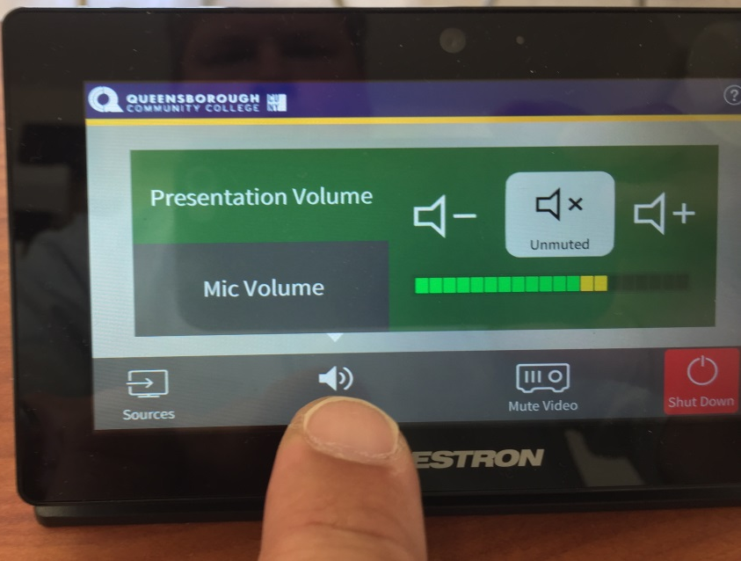
CP-II Podium Training
Controlling Audio for Source and Microphone
Upon startup the audio controls will automatically be set to a default level for the active source and the podium microphone.

Slide 12
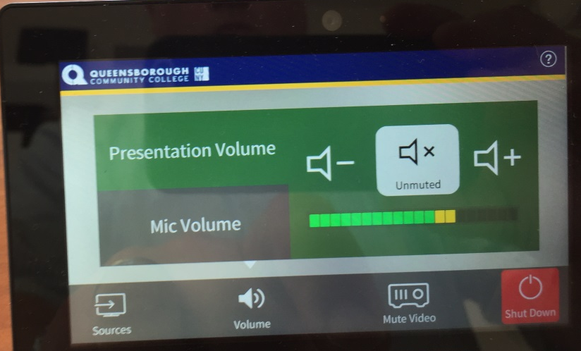
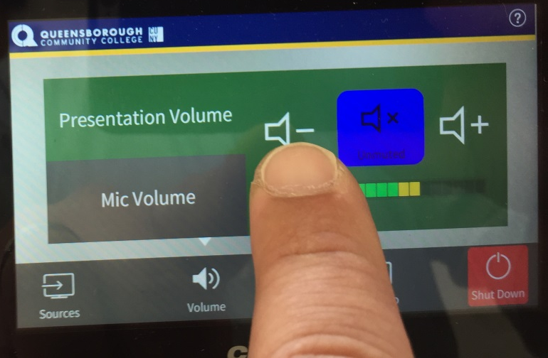
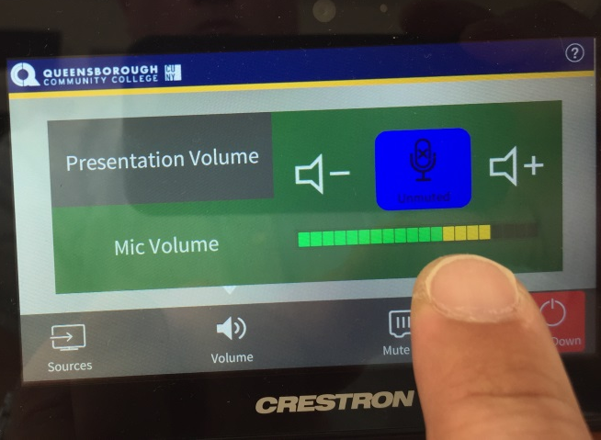
CP-II Podium Training
Controlling Audio for Source and Microphone
You can mute, as well as, adjust audio levels for active presentation source or microphone as shown below. Note: volume button will toggle to blue when muted and grey when not.

Slide 13
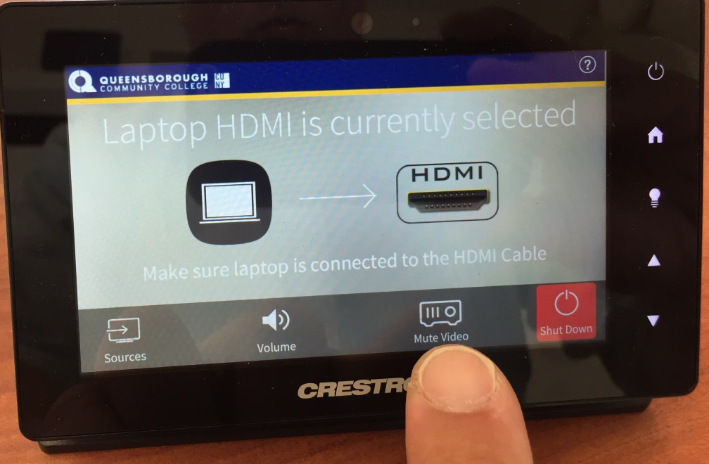
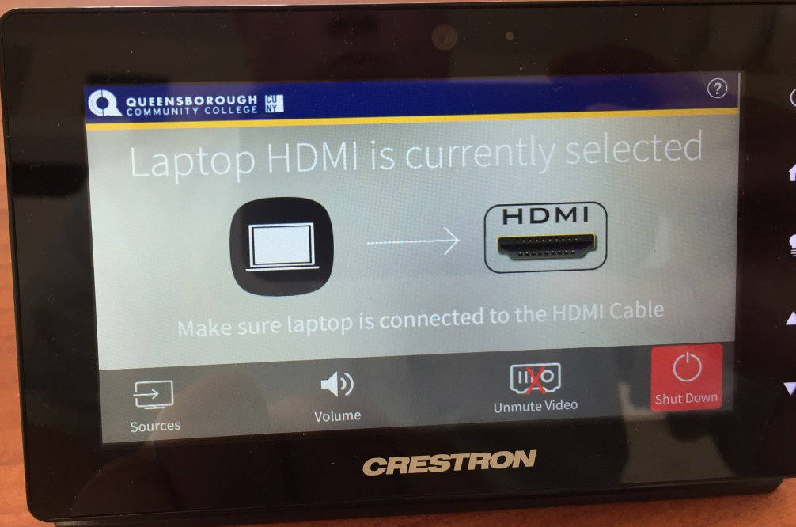
CP-II Podium Training
Mute the Projector
You can mute the projector image so your class cannot see what you have on your screen by pressing the “Mute Video” icon as shown below. You can un-mute, by pressing the button again. A red X will appear over the icon when muted.

Slide 14
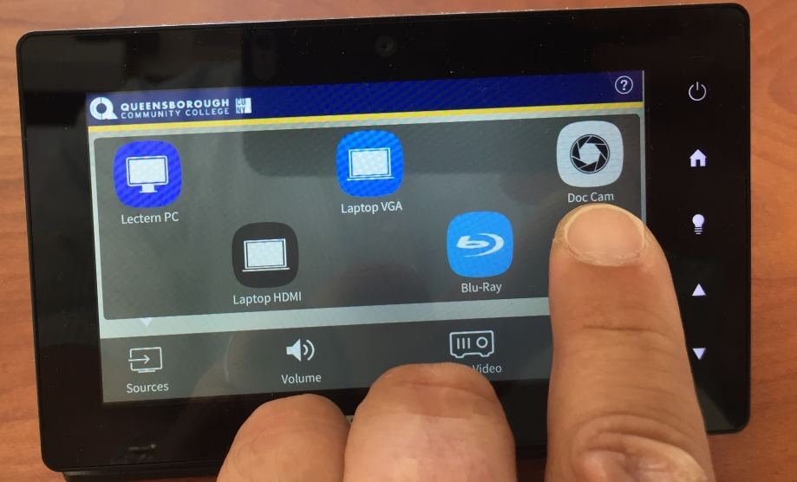
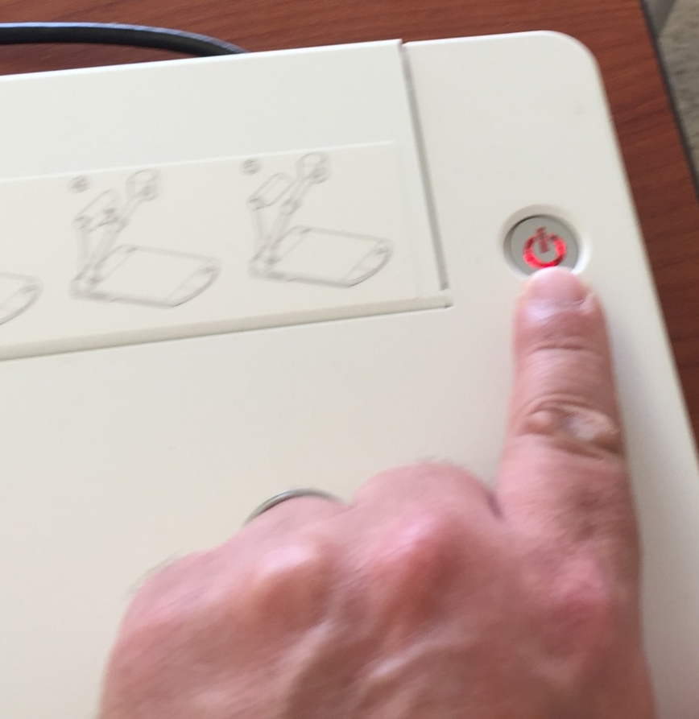
CP-II Podium Training
Using the Document Camera
To use the document camera, select “Doc Cam” from touch panel, hold down the power button for 4 seconds to power on the Elmo unit.

Slide 15
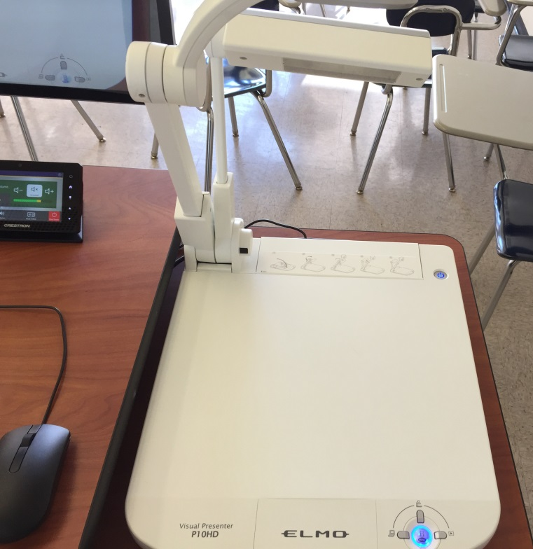
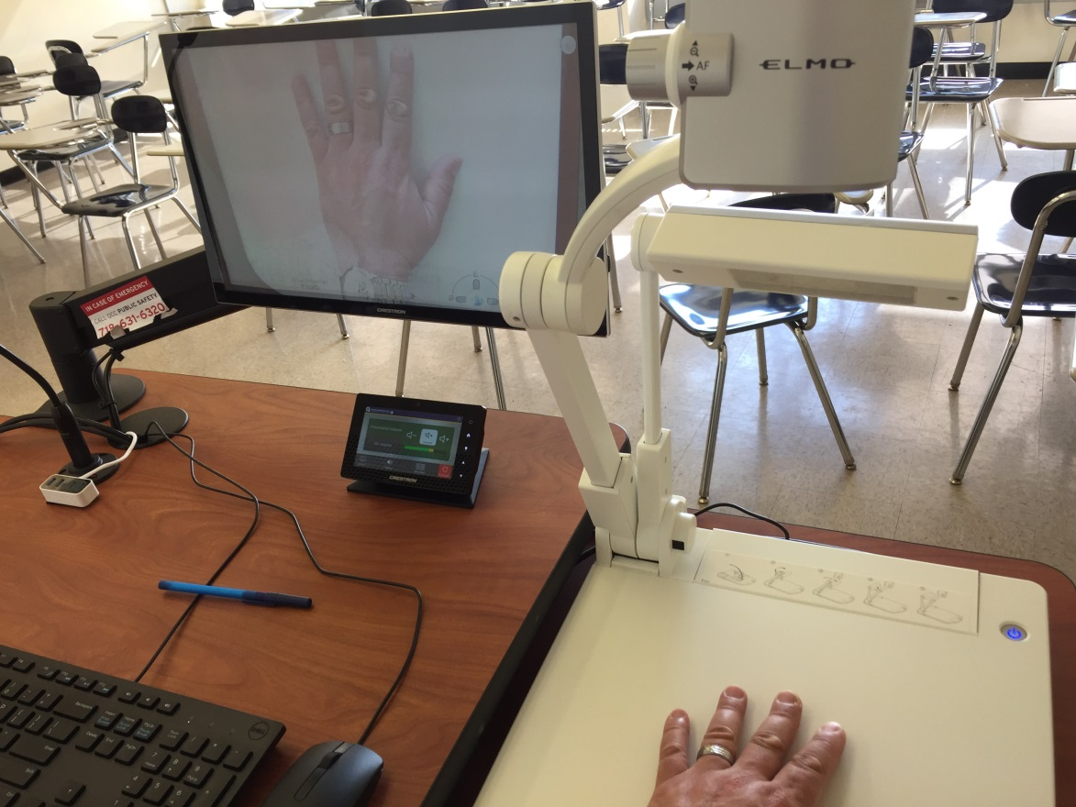
CP-II Podium Training
Using the Document Camera
The document camera will show a blue light and image will appear on the confidence monitor.

Slide 16
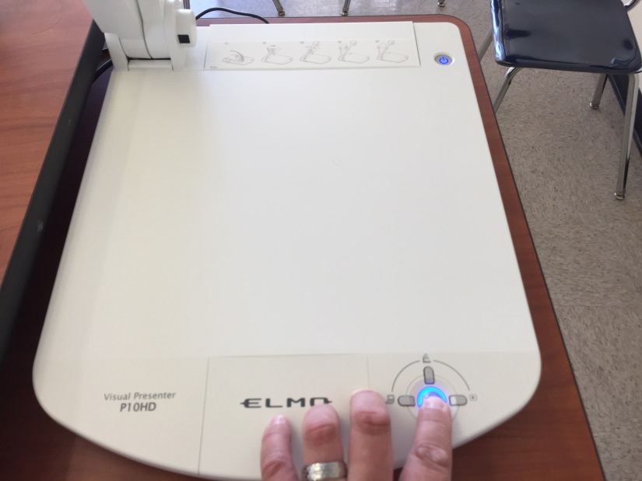
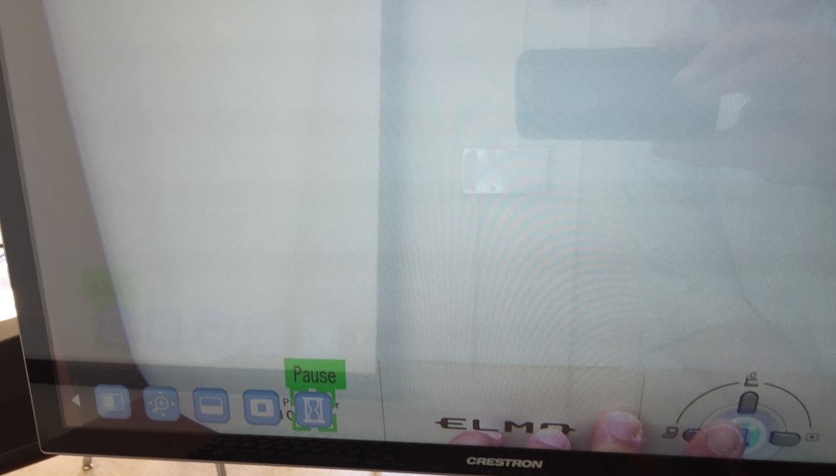
CP-II Podium Training
Using the Document Camera
To freeze the document camera image press the menu button and left key to navigate and select the Pause (hour glass) function as shown, press menu to engage and then click again to exit to Live mode.

Slide 17
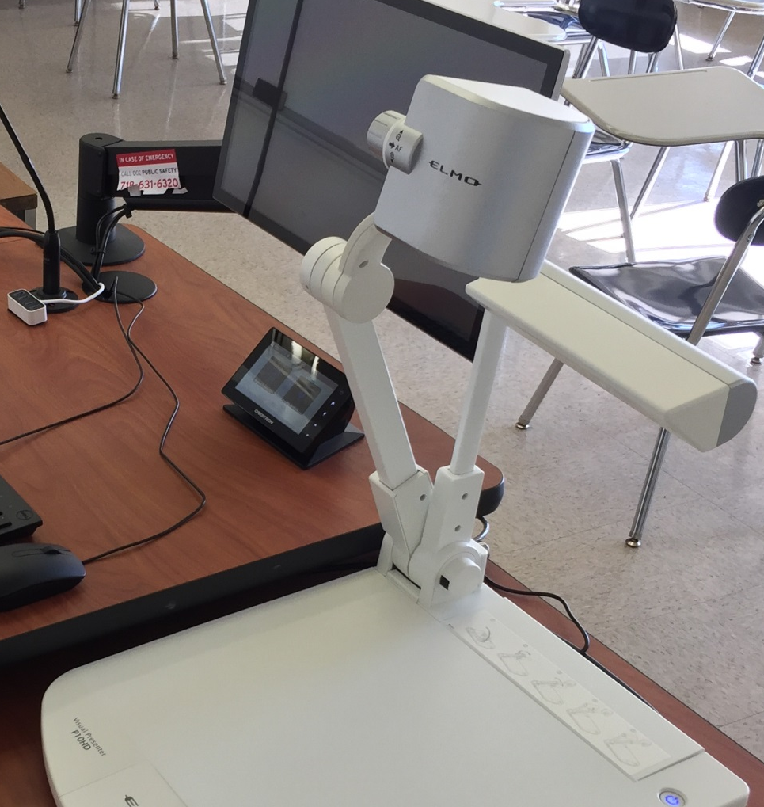
CP-II Podium Training
Using the Document Camera
You can adjust zoom level by using the wheel control on top of the camera or through the menu button

Slide 18
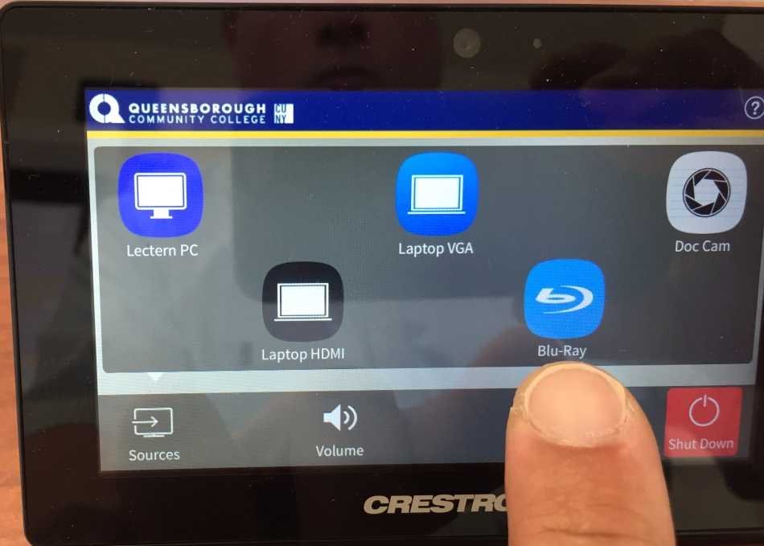
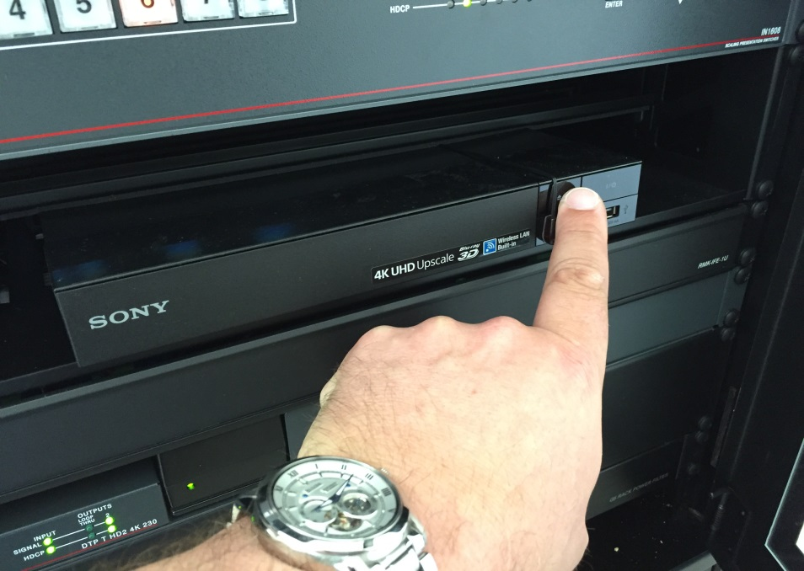
CP-II Podium Training
Using the Blu-Ray Player
Select Blu-Ray from the touch panel and in podium cabinet, click on eject button to insert DVD/Blu-Ray media. You can operate player using controls on the touch panel.

Slide 19
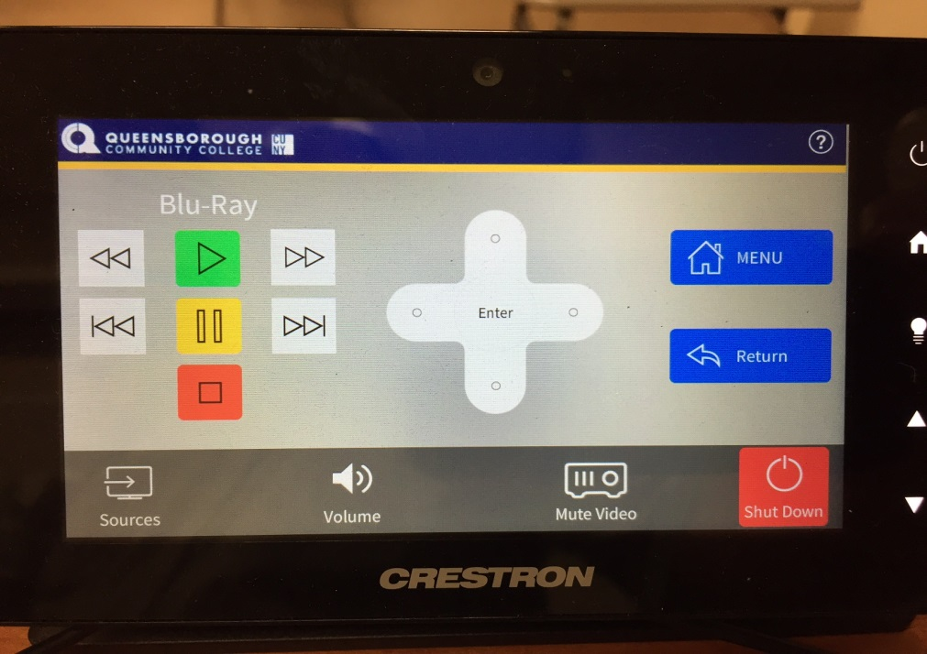
CP-II Podium Training
Using the Blu-Ray Player
Once you’ve selected Blu-Ray button on the touch panel the Blu-Ray submenu will appear where you can operate using buttons as shown.

Slide 20
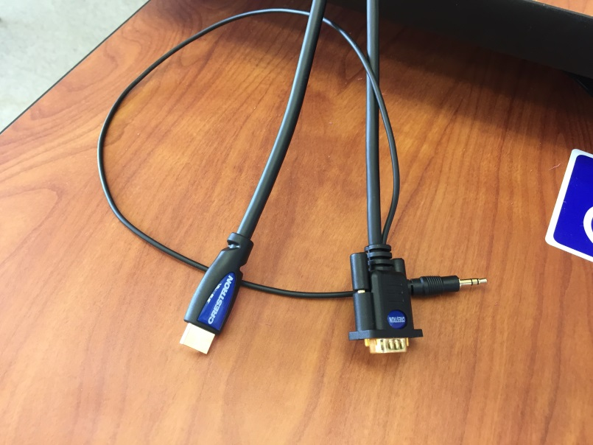
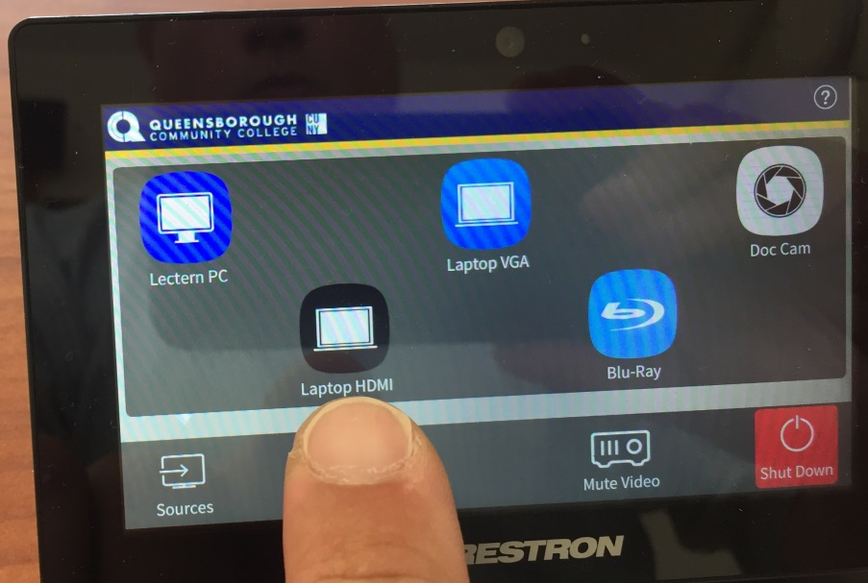
CP-II Podium Training
Using Own Laptop, MacBook or Other Device
If you have a laptop, iPad or MacBook with appropriate adaptor you can use either HDMI or VGA cables provided and then select either Laptop VGA or Laptop HDMI button.

Slide 21
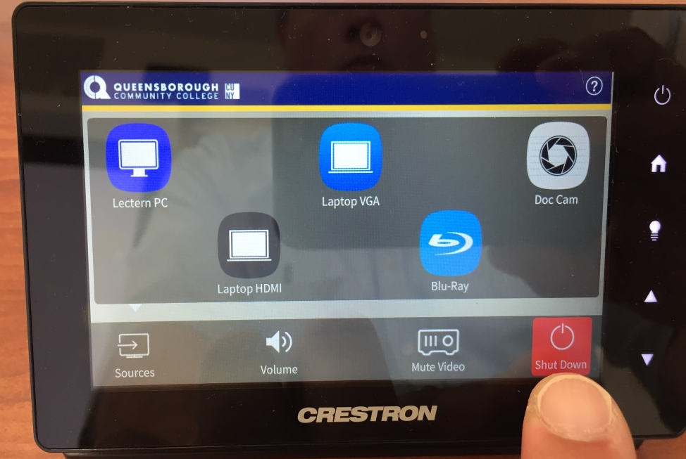
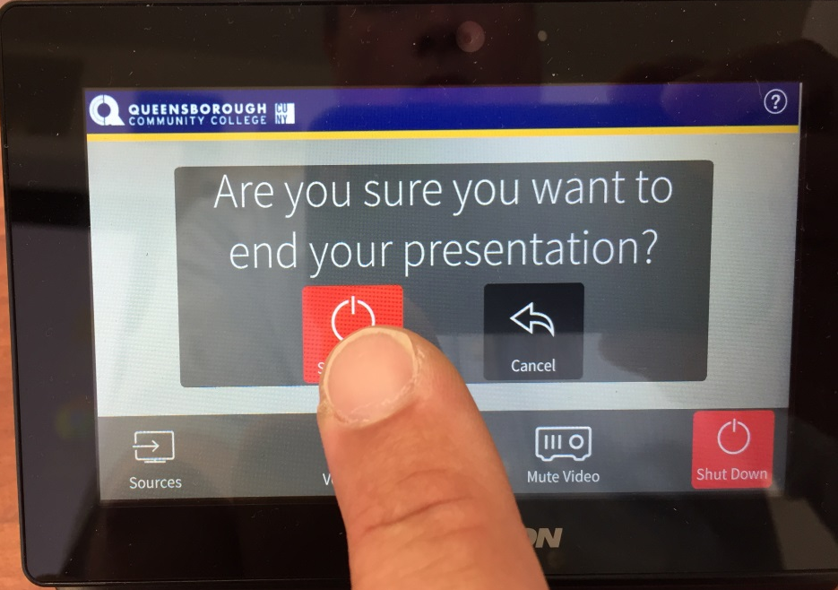
CP-II Podium Training
Shutting Down the Projector
When you are finished with your presentation, choose the “Shut Down” button and then choose again to confirm. This will turn off the projector, but will leave all other equipment operational.
Make sure you take your flash drive and log out of personal accounts before you leave!

Slide 22
CP-II Podium Training
Thank you!!!
For Questions and Help
Please contact the Academic Computing Center
  By Phone at 718-631-6624
  Or Email Mark Chropufka, Academic Technology Director, mchropufka@qcc.cuny.edu

